Slide 1
The Remanufacturing Industry in Europe
Networking Event: Challenges and Perspectives in Remanufacturing
Grenoble, France
March 15th 2016
David Fitzsimons

Slide 2


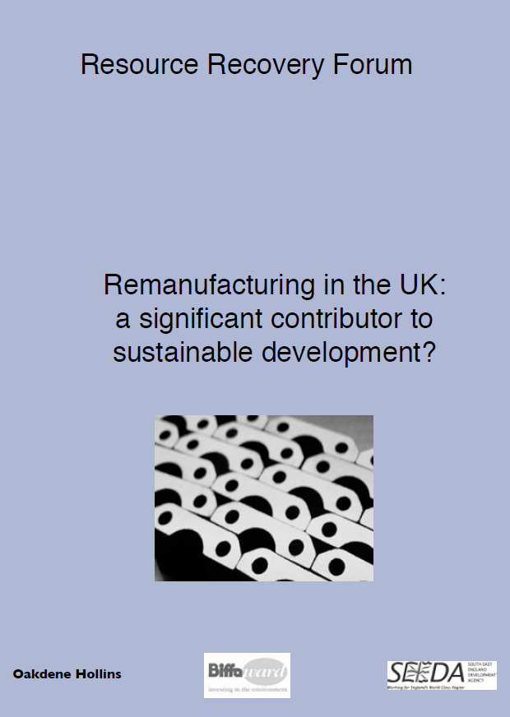
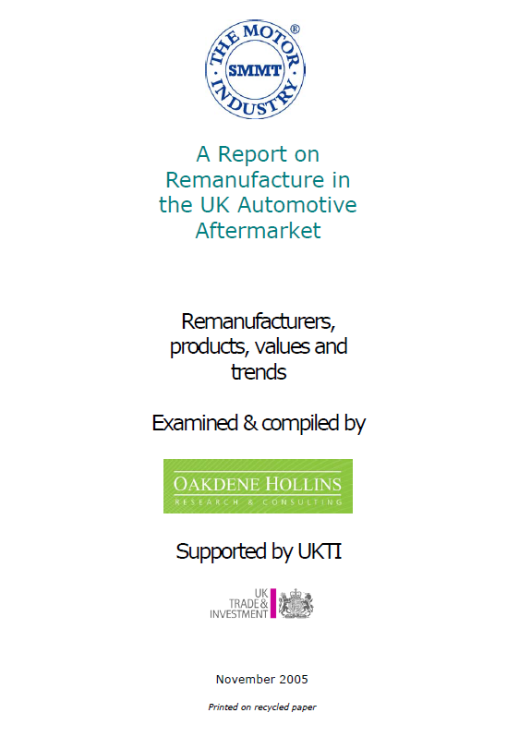
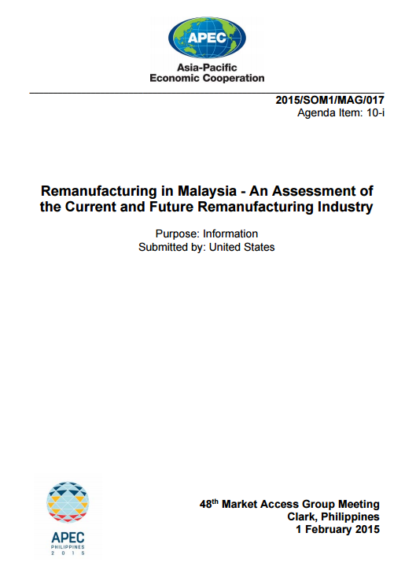
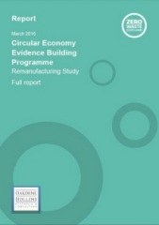
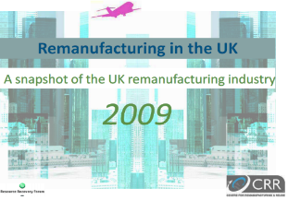
About CRR
Encouraging Remanufacturing & Reuse for 10 years
Funded by UK government until 2010
Advisory services:
  Market research
  Public procurement of remanufactured products
  Support in certification of remanufacturing processes to BS8887-220
  Environmental impact studies

Slide 3
Remanufacturing sweet spot
Value
high
Embedded value
Labour-v-materials
Specialties
low
Remanufacturing Engineering Potential
Evolution rate
Technology change
Legislation
Upgrade potential
Re-constructability
Construction
Remediation
Knowledge
© Centre for Remanufacturing & Reuse
9 sectors

Slide 4
Economic contribution: €30bn
Turnover / €bn

Slide 5
Social contribution: >190,000 jobs
Employment / ‘000

Slide 6
Environmental contribution
>2,000 kt material
>8,000 kt CO₂e
>3,000 kt
>3,000 kt
’000 kt

Slide 7
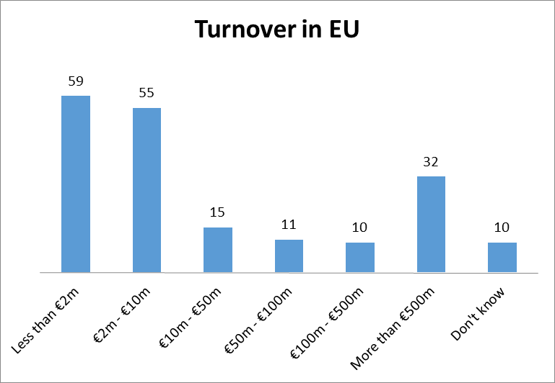
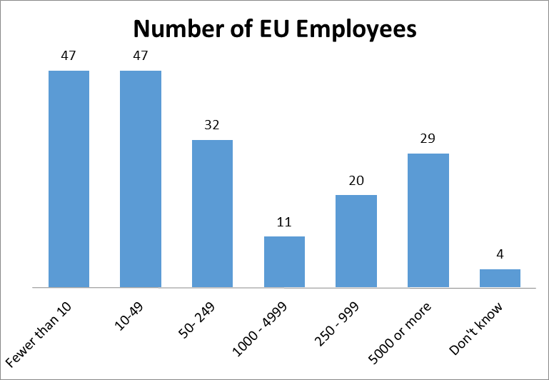
Characterisation of EU remanufacturers (I)

Slide 8
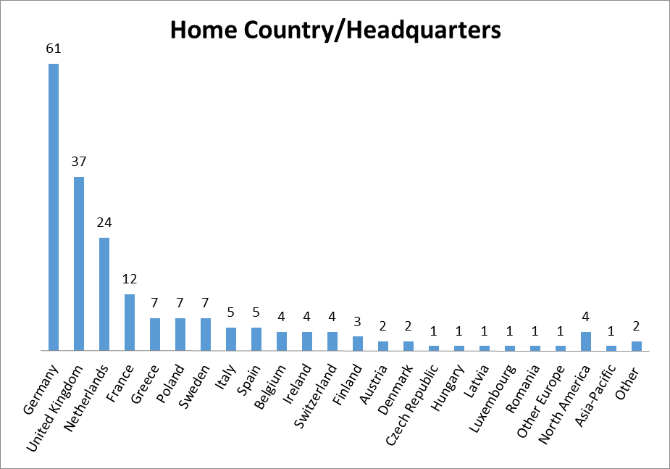
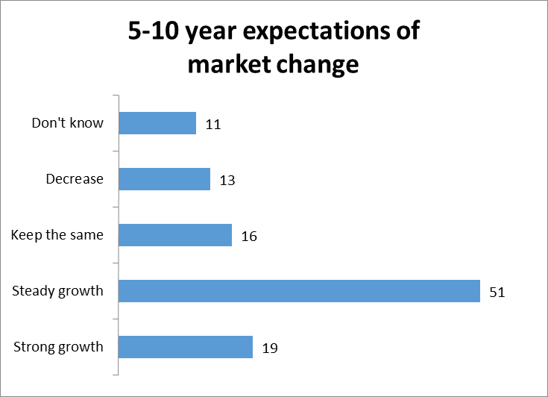
Characterisation of EU remanufacturers (II)

Slide 9
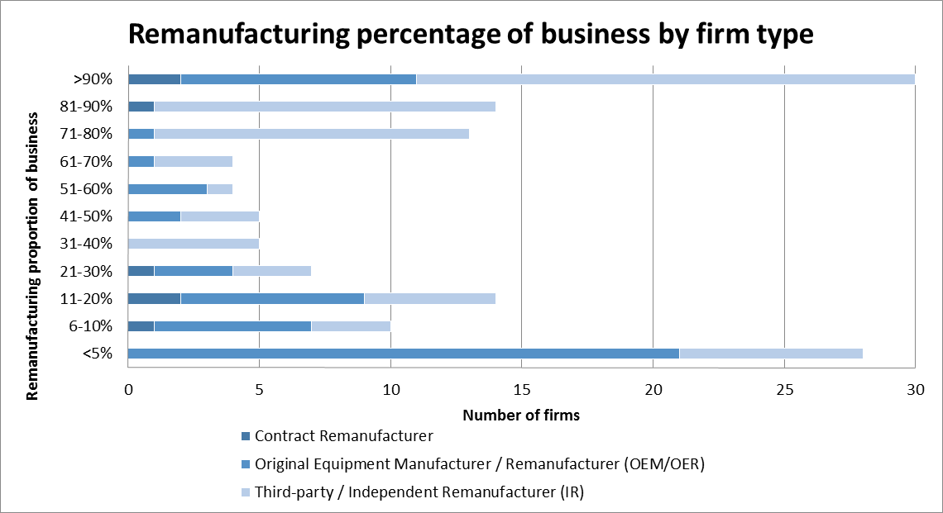
Characterisation of EU remanufacturers (III)

Slide 10
Motivations: Importance for Remanufacturing

Slide 11
Barriers: Importance for Remanufacturing

Slide 12
Supports Circular economy Action Plan
Directly contribute to EU’s objectives to support:
  Employment
  Economic growth
  Investment
  Commitment towards sustainable development
  Green growth
  Resilient Energy Union
Notes:
Moreover, eco-industries and eco-innovation currently supply a third of the global market for green technologies, worth a trillion euro and expected to double by 2020. This initiative aims to reinforce this trend, thus contributing to green growth and to other EU priorities such as the work towards developing a Resilient Energy Union with a Forward-Looking Climate Change Policy

Slide 13
Questions
How big a role will remanufacturing take in the Circular Economy Action Plan?
  Mentioned 4 times
  Does not feature in annex of actions
Where will remanufacturing support come from moving forward?
What co-ordinated action is required?

Slide 14
European Remanufacturing Council
Play leadership role for remanufacturing industry in Europe, influence policy communication
Discuss issues and pursue actions of common interest
  Standards, legislative barriers, customer recognition / communication, core availability/quality, green public procurement, tax relief, etc.
In time and if there is appetite, the ERC may be supported by:
  Subcommittees focusing on key issues e.g. standards, policy & trade, marketing, research & development
To express interest, contact: erc@remanufacturing.eu

Slide 15
Thank you for listening

