Slide 1

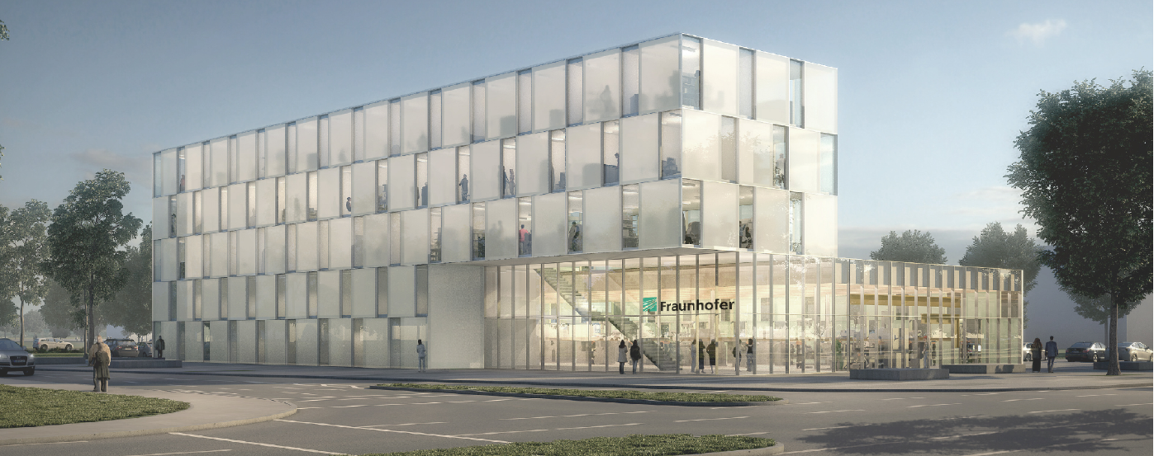
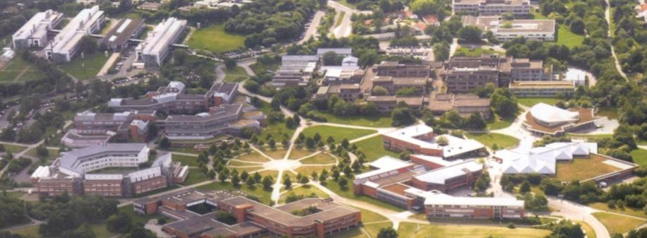
ERN Workshop
Best practices and future challenges in remanufacturing
Remanufacturing Processes
Grenoble, March 2016
Dipl.-Wi. Ing. (FH) Steffen Butzer M.Sc.

Slide 2
Agenda
Introduction
Remanufacturing Processes
Generic Remanufacturing Processes
Case Studies
Remanufacturing and Advanced Materials
Todays and Tomorrows Challenges
Remanufacturing Processes Toolkit
Remanufacturing Process Assessment

Slide 3
Agenda
Introduction
Remanufacturing Processes
Generic Remanufacturing Processes
Case Studies
Remanufacturing and Advanced Materials
Todays and Tomorrows Challenges
Remanufacturing Processes Toolkit
Remanufacturing Process Assessment

Slide 4
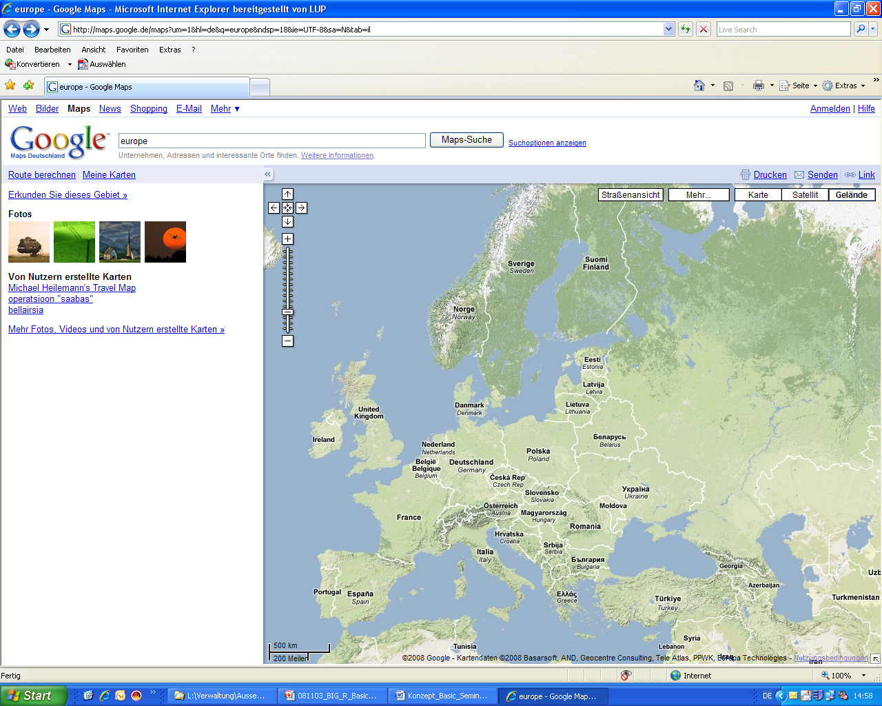

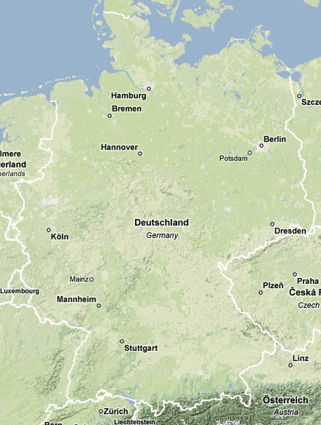
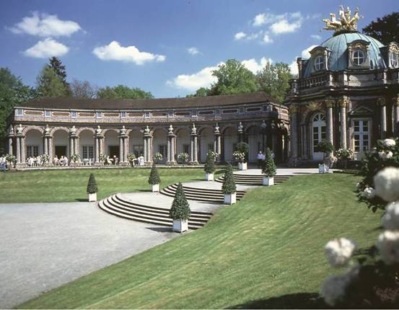
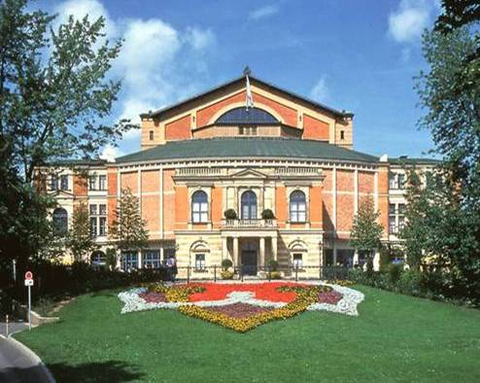
Introduction
Bayreuth
Europe
Bayreuth
Population: 75,000
World-renowned for
Richard Wagner Festival
Half way between
Munich & Berlin
Germany
Bayreuth
Munich
Images: maps.google.de

Slide 5
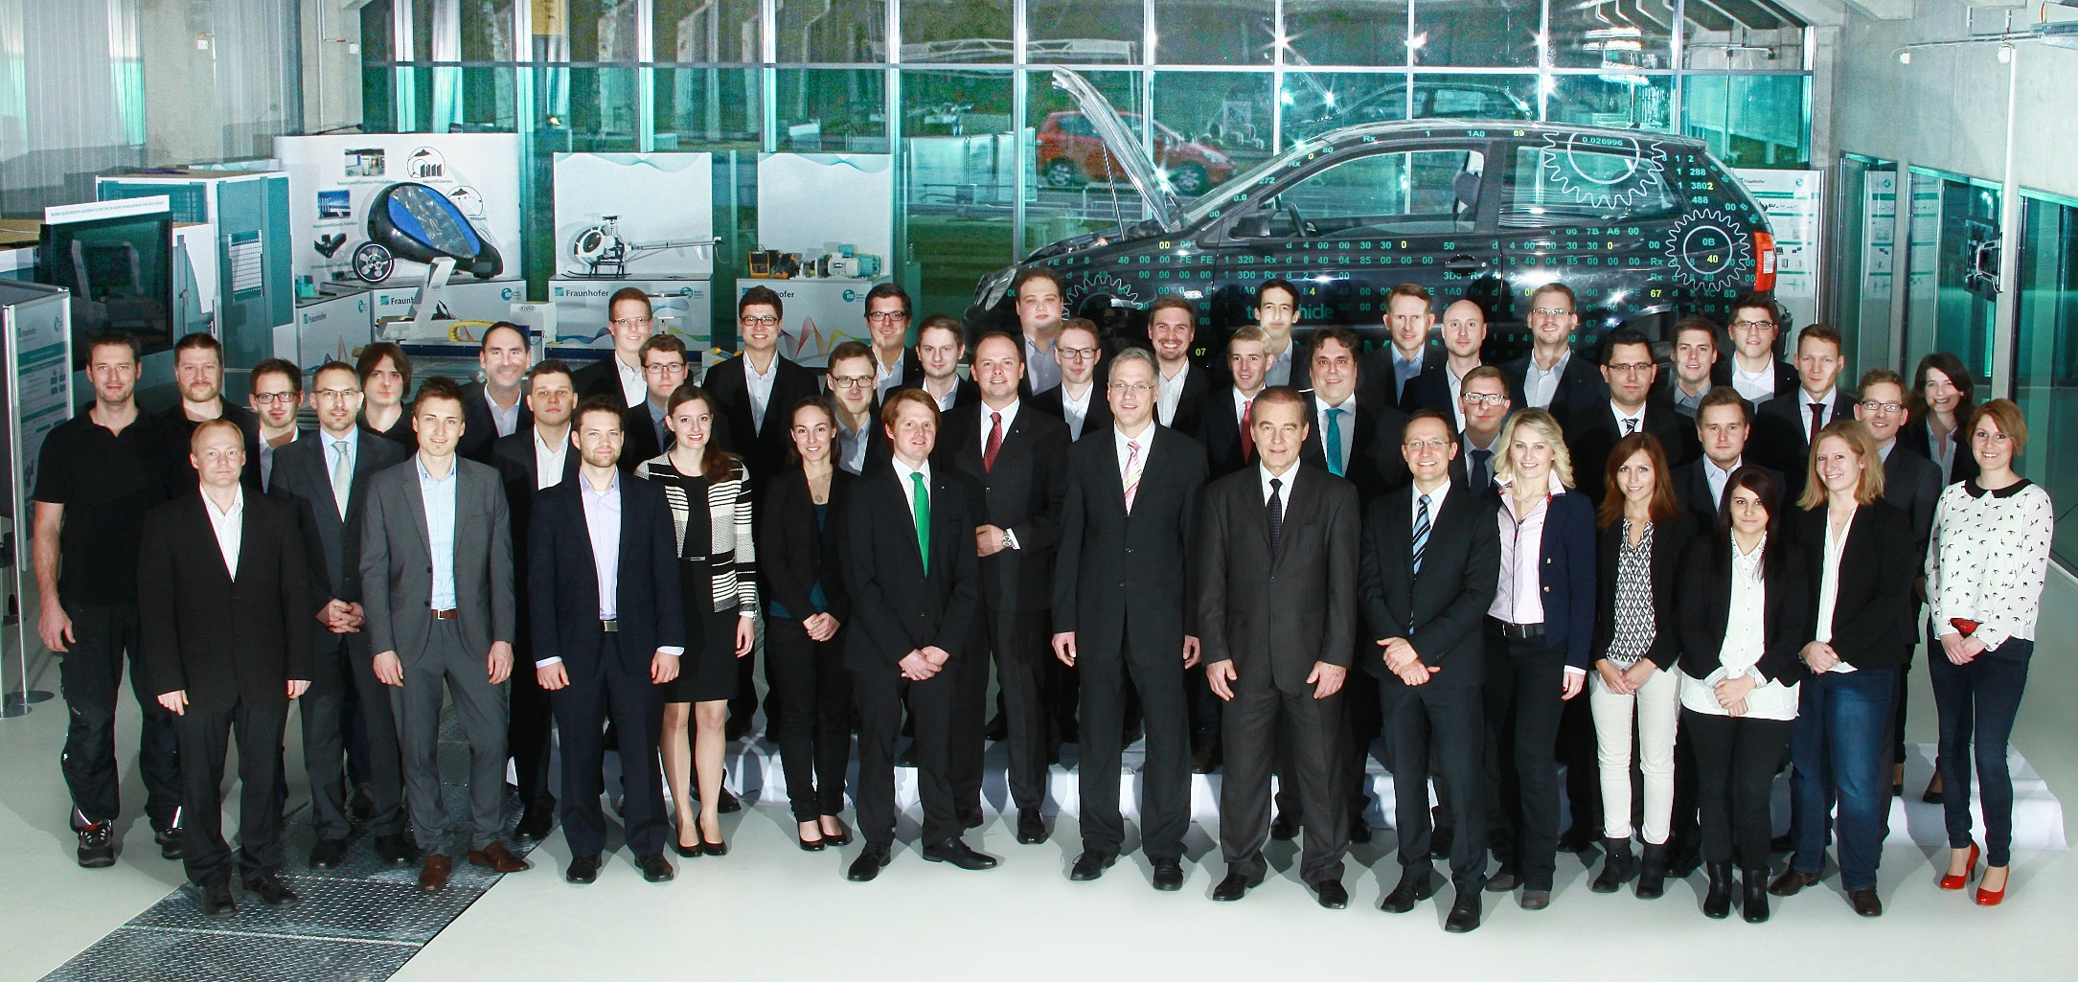
Introduction
Our Team

Slide 6
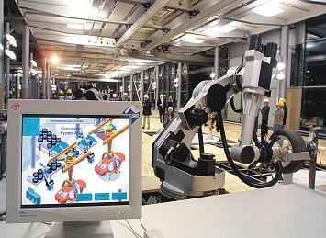
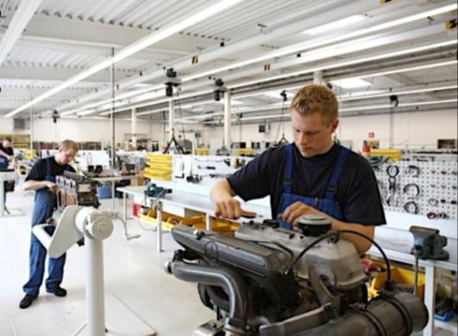
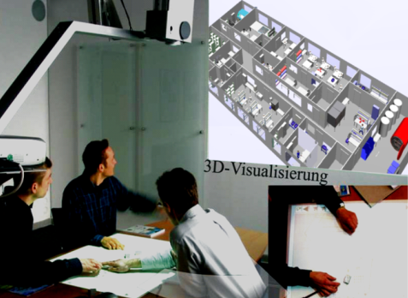
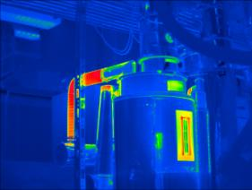
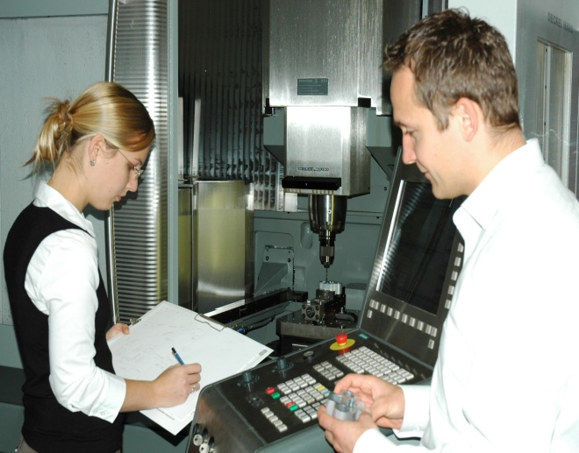
Fraunhofer Project Group Process Innovation
Scopes of business
Remanufacturing
Production management
Technology management
Resource efficiency

Slide 7
Agenda
Introduction
Remanufacturing Processes
Generic Remanufacturing Processes
Remanufacturing Processes Toolkit
Case Studies
Remanufacturing and Advanced Materials
Todays and Tomorrows Challenges
Remanufacturing Processes Toolkit
Remanufacturing Process Assessment

Slide 8
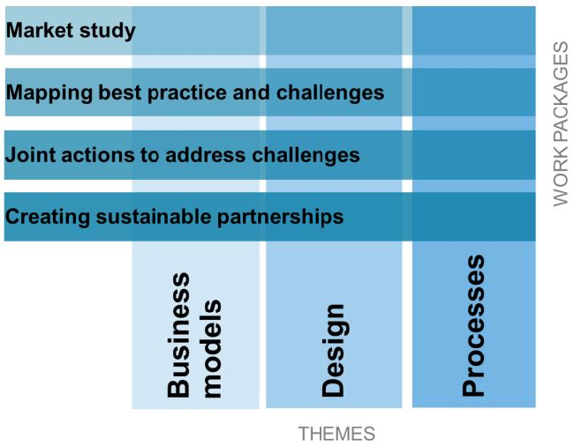



Remanufacturing Processes
ERN – European Remanufacturing Network
Encourage new businesses to take up remanufacturing
Help existing remanufacturers improve their operations
Improve competitiveness of remanufacturers
Create greater awareness of remanufacturing
Notes:
Understand current remanufacturing processes
Technical processes e.g. cleaning technologies
Organizational processes e.g. production control and planning
Collect and disseminate information including best practices and challenges
Educate people in seminars and discuss key topics
Publish remanufacturing processes toolkit
Initialize research projects to address challenges

Slide 9
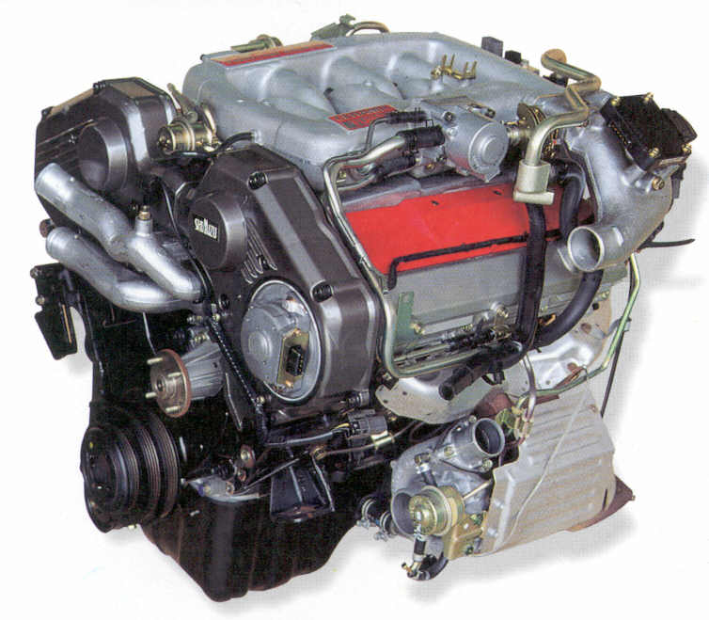

Remanufacturing Processes
Remanufacturing: „Good as New“ in Five Steps
UP
Markets and Legislation
both drive Remanufacturing
Assembly
Disassembly
Cleaning
Reconditioning
Testing
Multiple
Product
Lives
UPcycling
Recycling
Downcycling
Notes:
For electronic components one step more is necessary which is the entrance diagnosis

Slide 10
Agenda
Introduction
Remanufacturing Processes
Generic Remanufacturing Processes
Case Studies
Remanufacturing and Advanced Materials
Todays and Tomorrows Challenges
Remanufacturing Processes Toolkit
Remanufacturing Process Assessment

Slide 11
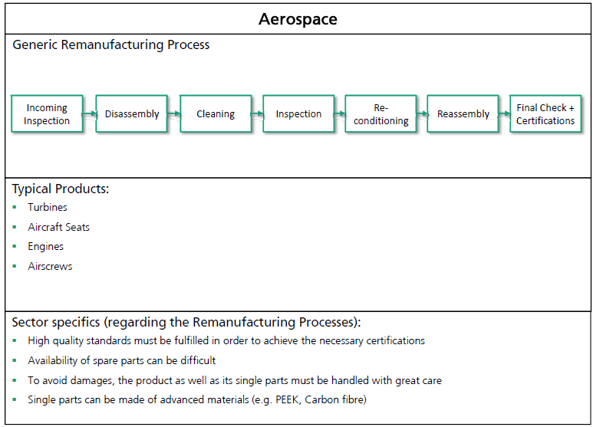
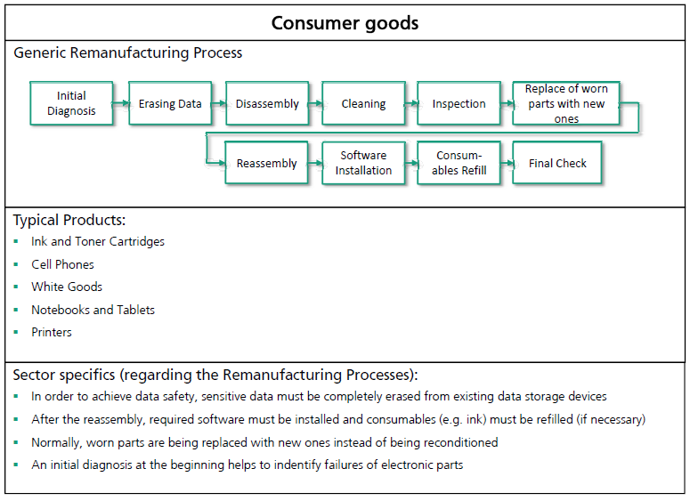
Generic Remanufacturing Processes
Notes:
Literature research based on the market study results
How does European companies remanufacture?
What are the differences between the processes
For each of the 9 industry sectors
Aerospace
Automotive
Consumer goods
Furniture/office furniture
Heavy duty and off road equipment
Machinery
Marine Industry
Medical equipment
Rail industry

Slide 12
Agenda
Introduction
Remanufacturing Processes
Generic Remanufacturing Processes
Case Studies
Remanufacturing and Advanced Materials
Todays and Tomorrows Challenges
Remanufacturing Processes Toolkit
Remanufacturing Process Assessment

Slide 13
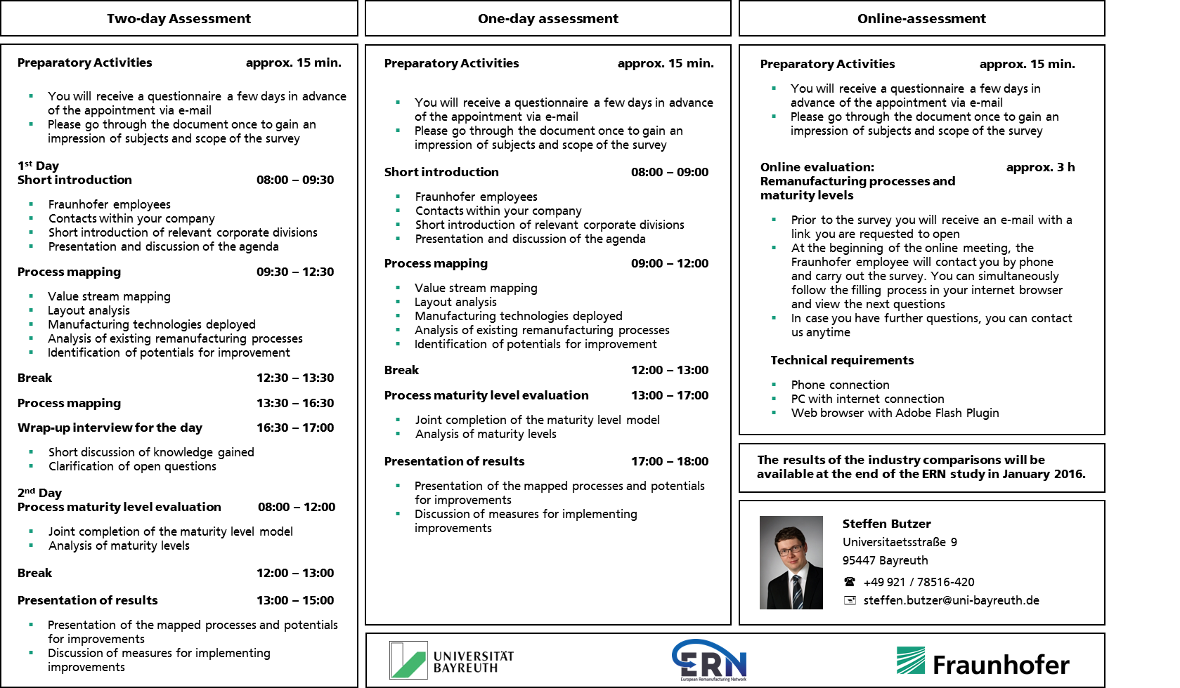
Case Studies
Remanufacturing Process Assessment - Overview
Notes:
We have three options on how to participate and profit from the process assessment.

Slide 14
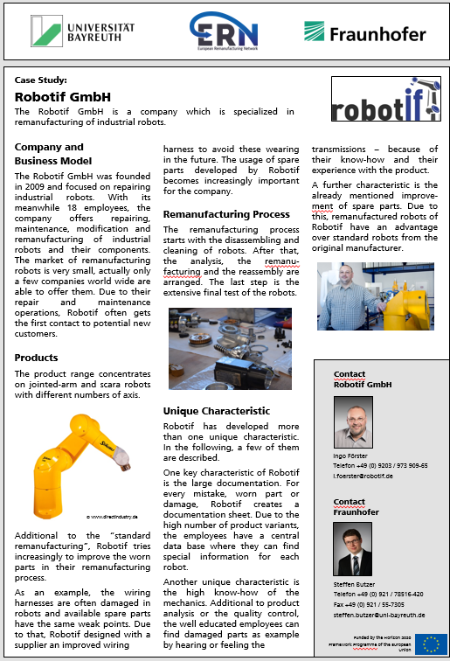
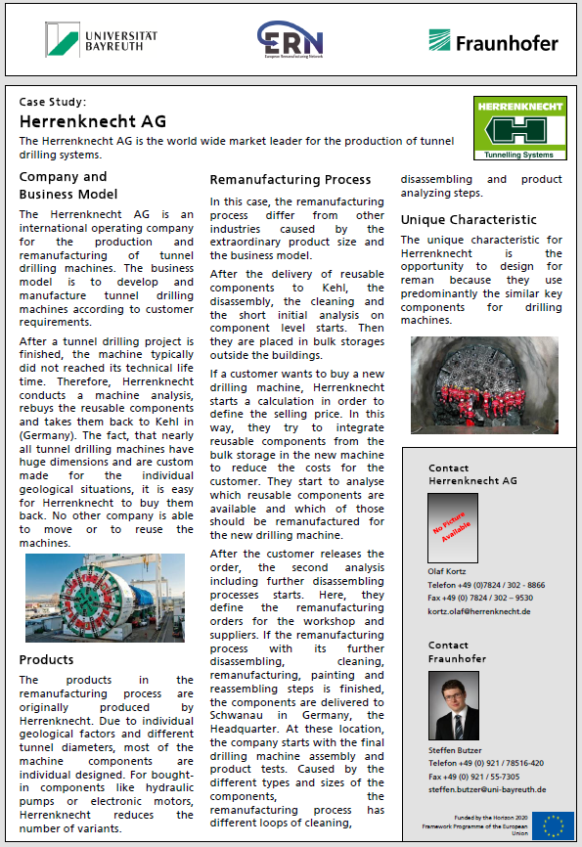
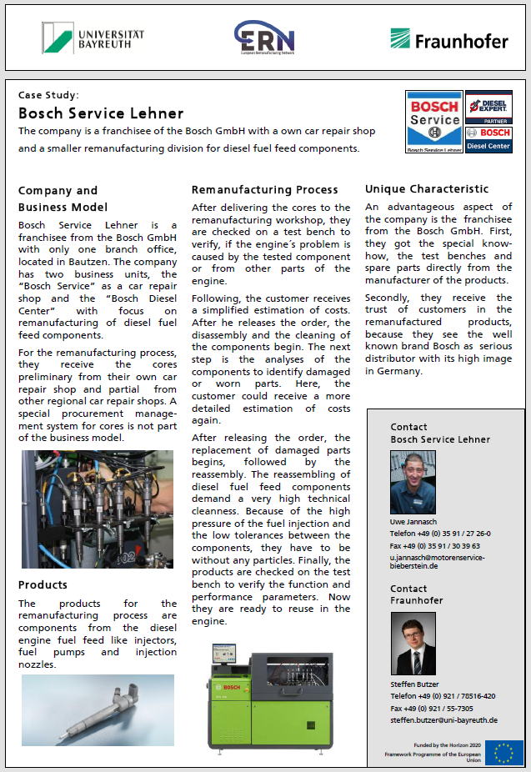
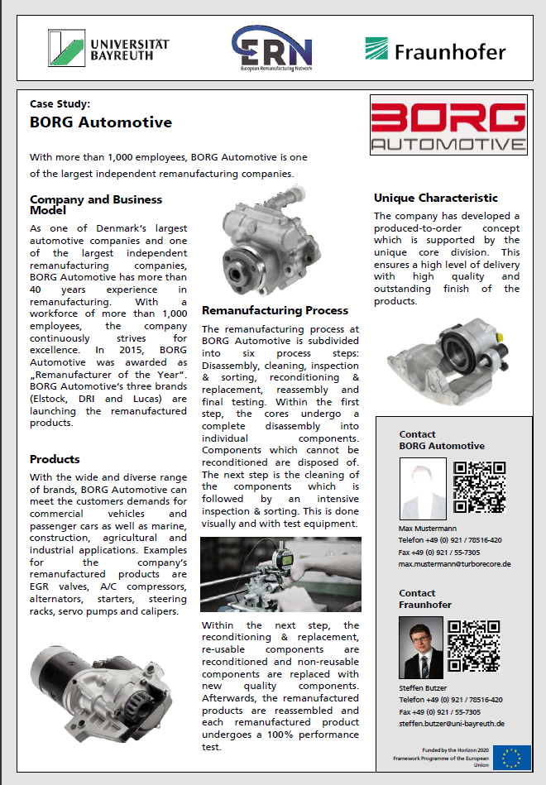
Case Studies
One pagers
Notes:
Concrete examples on how to remanufacrure successful within Europe
We have assessed 10 companies by now (mainly from the automotive sector)
We will keep going and will hopefully get a lot more case studies
Topics:
Processes: How do they remanufacure
Connection (interdependency) to the business situation
The advanced materials recovered

Slide 15

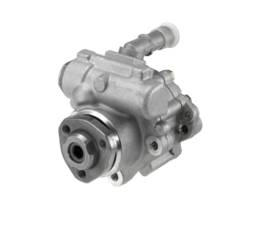
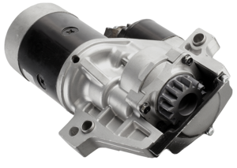
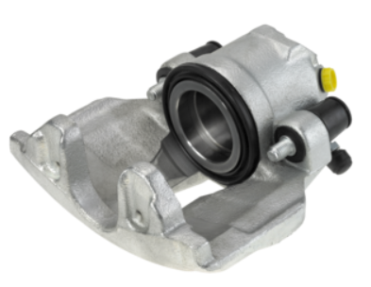
Case Studies
Borg Automotive
Company and business model:
One of Denmark‘s largest automotive companies
One of the largest independent remanufacturing companies
40 years of experience
More than 1000 employees
Remanufacturer of the year in 2015
Products:
Wide and diverse range of brands
Commercial vehicles, passenger cars, marine and agricultural sector
Alternators, starters, steering racks
Remanufacturing process:
Disassembly
Cleaning
Inspection & sorting
Reconditioning & replacement
Reassembly
Final testing
Unique characteristic:
Produced-to-order concept
Notes:
I would like to present to you two totaly different cases today.
The first one is from the company borg automotive
(Concept ensures short delivery times)

Slide 16

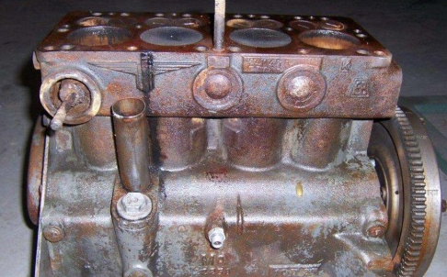
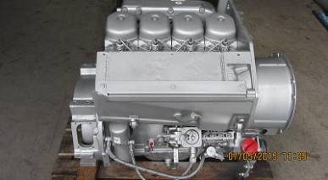
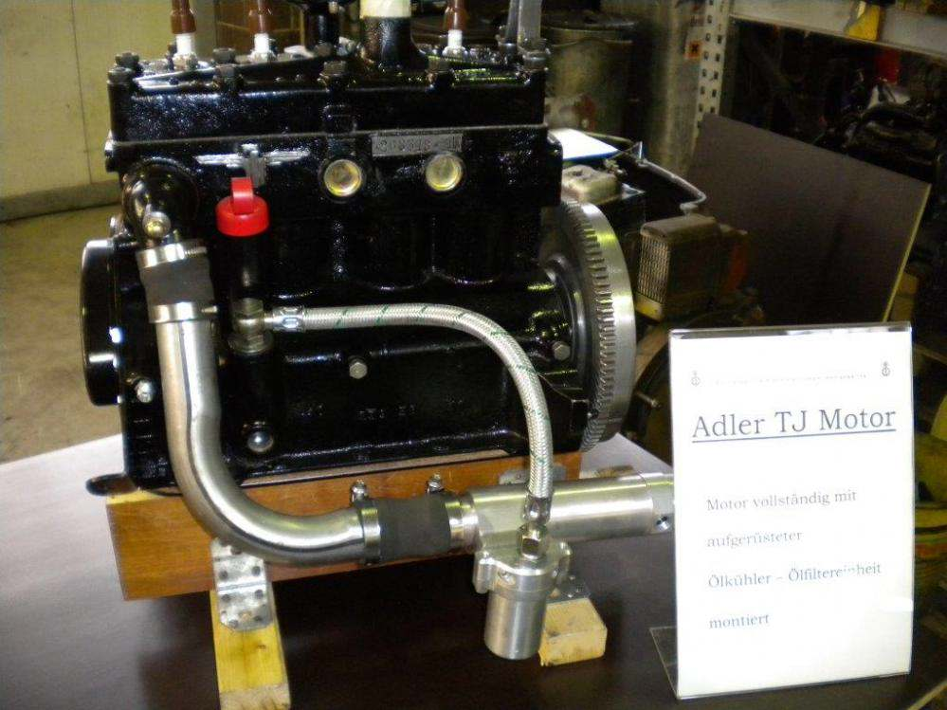
Case Studies
Motorenservice Bieberstein GmbH
Company and business model:
Independent remanufacturer
15 employees
86 years of experience
Products:
Diesel engines
Agricultural and construction machines
All sizes including older series
Remanufacturing process:
Incoming analysis
Cost estimation
Disassembly
Cleaning
Detailed analysis
Reconditioning and replacement
Reassembly
Final testing
Unique characteristic:
Extense experience in the sector of diesel engines
Notes:
The second company is: Bieberstein, a SME located in Eastern Germany
The companies are totally different, not only the size also the concept and processes. But anyhow both do a great job in the field of remanufacturing since years.

Slide 17
Agenda
Introduction
Remanufacturing Processes
Generic Remanufacturing Processes
Case Studies
Remanufacturing and Advanced Materials
Todays and Tomorrows Challenges
Remanufacturing Processes Toolkit
Remanufacturing Process Assessment

Slide 18
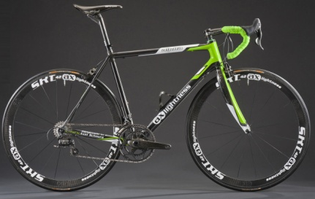
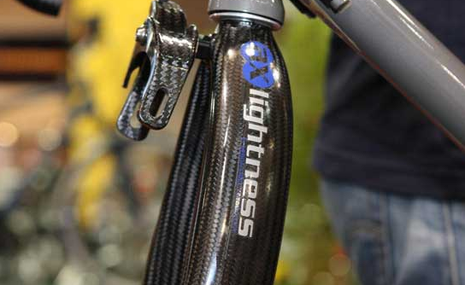
Remanufacturing and Advanced Materials
Internet Research
Preliminary results
Notes:
During our process assessments we found out, that not many remanufacturers care about new and advanced materials, therfore we turned around the question,
and did a internet research about who is active in the field of remanufacurirng / repairing of new and advanced materials
Here are the results:
Mainly in the sector: Consumter goods, e.g. bicycles

Slide 19
Agenda
Introduction
Remanufacturing Processes
Generic Remanufacturing Processes
Case Studies
Remanufacturing and Advanced Materials
Todays and Tomorrows Challenges
Remanufacturing Processes Toolkit
Remanufacturing Process Assessment

Slide 20
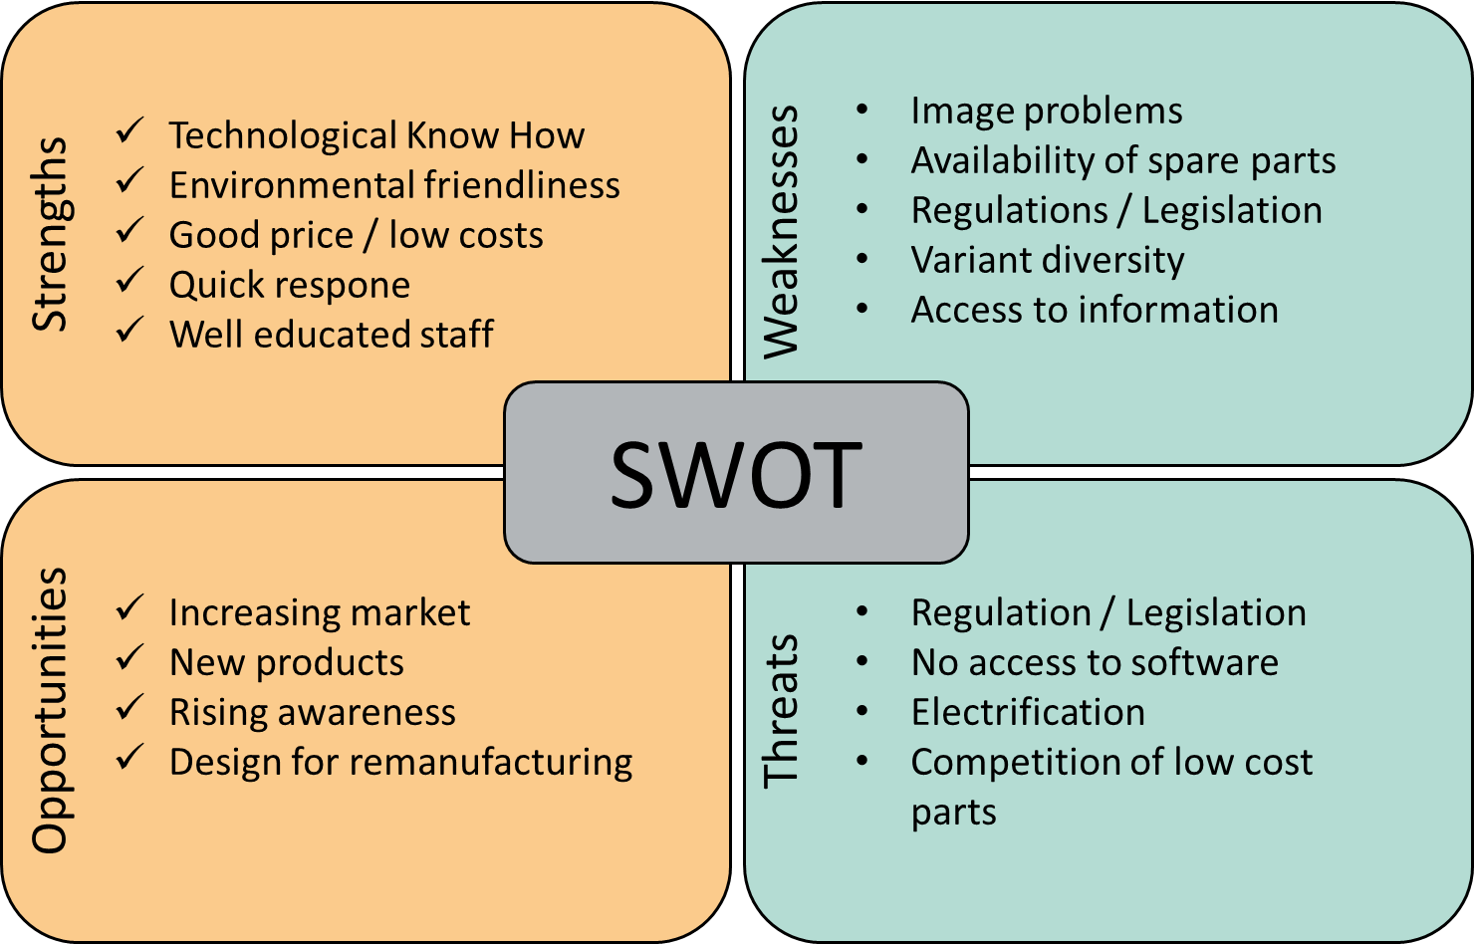
Todays and Tomorrows Challenges
SWOT Analysis - Today
Preliminary results based on a workshop in Bayreuth with 42 participants

Slide 21
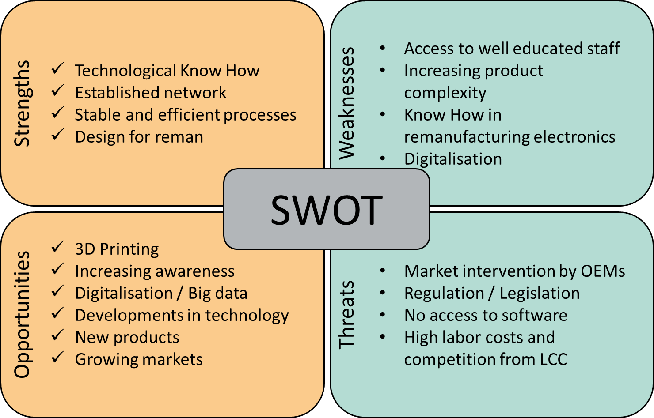
Todays and Tomorrows Challenges
SWOT Analysis - Tomorrow
Preliminary results based on a workshop in Bayreuth with 42 participants

Slide 22
Agenda
Introduction
Remanufacturing Processes
Generic Remanufacturing Processes
Case Studies
Remanufacturing and Advanced Materials
Todays and Tomorrows Challenges
Remanufacturing Processes Toolkit
Remanufacturing Process Assessment

Slide 23
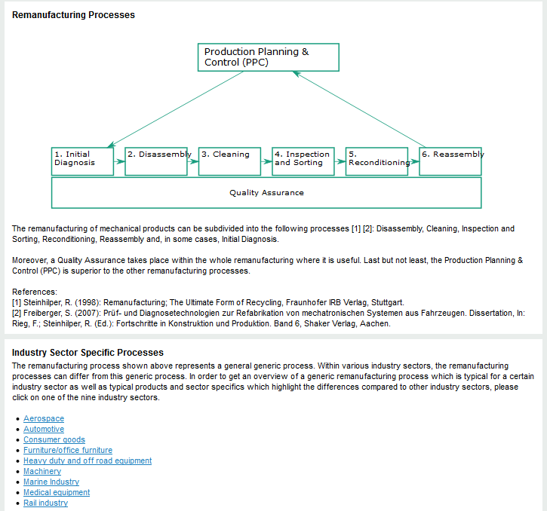
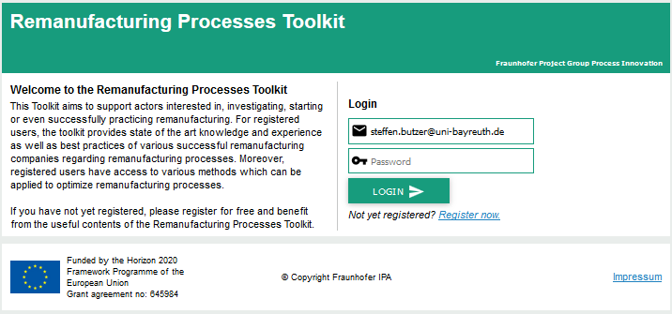
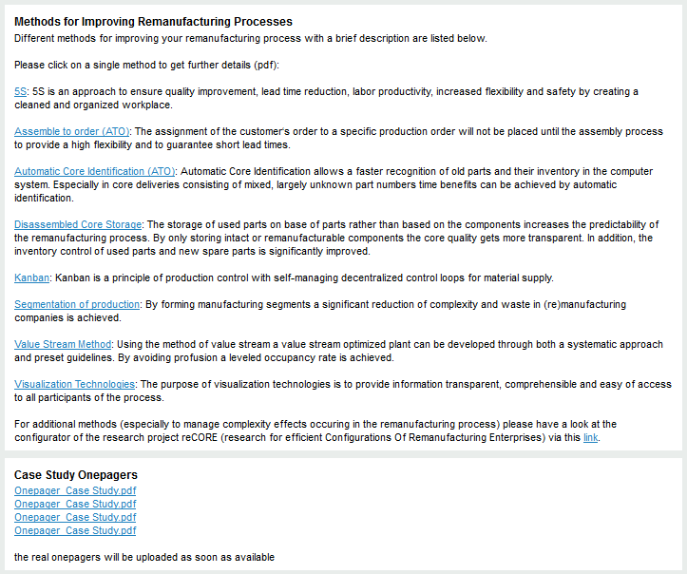
Remanufacturing Processes Toolkit
Mock-up
Notes:
All the information shown will be available on a webbased remanufacturing processes toolkit in April
Information about the processes
Sector specific processes
Methods to improve remanufacturing processes
Todays and tomorrows challenges
One pagers case studies
The toolkit will be updated regularly

Slide 24
Agenda
Introduction
Remanufacturing Processes
Generic Remanufacturing Processes
Case Studies
Remanufacturing and Advanced Materials
Todays and Tomorrows Challenges
Remanufacturing Process Assessment

Slide 25
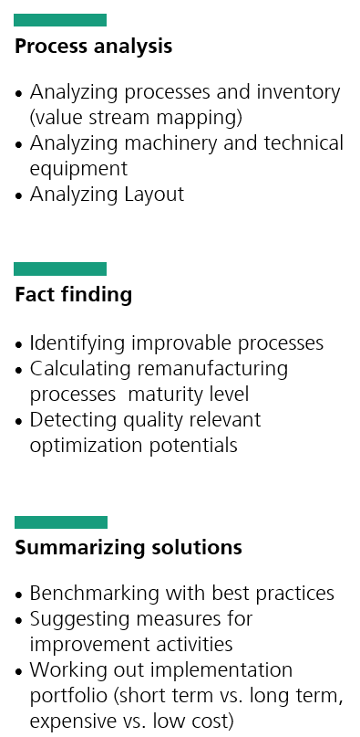
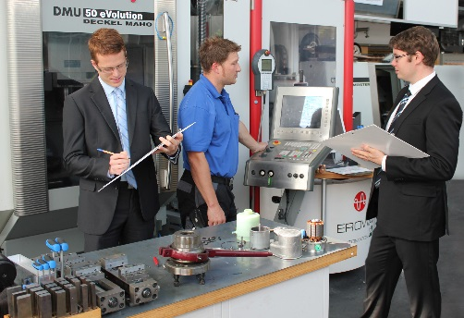
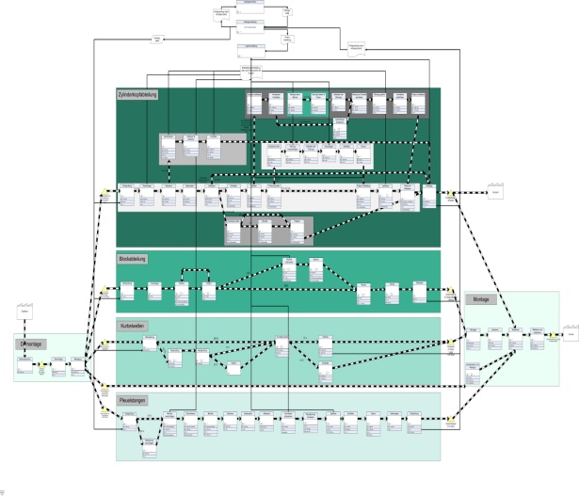

Remanufacturing Process Assessment
How you can participate und profit
Be a part of
and benefit from the ERN –
European Remanufacturing Network
Two-day assessment
of your remanufacturing operations
5.200.-€
_______
Notes:
How can you participate and profit from the ERN
It is still possible to get your processes assessed and to become one of our case studies
If you are interested in, please do not hesitate to contact us

Slide 26

Thank you for your attention
Steffen Butzer
M.Sc., Dipl.-Wi. Ing. (FH)
Universitaetsstrasse 9
95447 Bayreuth
Phone ++49 (0) 921 / 78516 420
Fax ++49 (0) 921 / 78516 105 steffen.butzer@uni-bayreuth.de
www.regenerative-produktion.fraunhofer.de
Notes:
Thank you very much for your attention.
If you have any question, I will be around the whole day.

