Slide 1
From useful to useful
An all-in-one service
designed for businesses

Slide 2
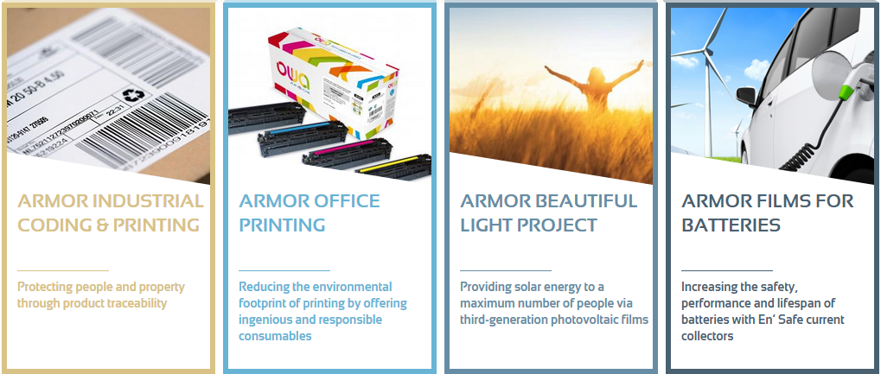
ARMOR: Industry-related innovation
From domestic beginnings to international operation
  Intermediate Sized Enterprise (ISE) based in Nantes, France
  2014 Turnover: €223M with 80% created from exports; up 55% from 2008
  2,000 staff (680 in France) across 26 subsidiaries and 11 production sites worldwide
Four major activities:
Investment in sustainable innovation and R&D:
2014-2018: €65M investment of which €50M in France
€1.6M invested every year in protecting people and the environment
Advanced Member of the UN Global Compact
World number 1
10% annual growth in production since 2000
European leader
No. 1 for remanufactured laser printer cartridges in France
3rd generation flexible organic photovoltaic film
En'Safe:
New business activity from 2015.
Current collecting films

Slide 3

WHY OWA?
Aims:
To develop a brand that covers not simply printer cartridges,
but an overall circular economy solution
To promote ARMOR's values: expertise, commitment and social innovation
WA = circle or ring in Japanese, representing circularity and the circular economy.
The word ends with a sound expressing openness, representing
curiosity, the desire to make progress, break ground, continue to develop
and move forward.
OWA also means Our Way to Act! Acting for a more responsible future,
The logo represents circularity, the very essence of the circular economy.
  OWA

Slide 4


Observations on society
Observations on society
Did you know?
6x the area of France; that's the size
of the 7th continent made of waste plastic!
2025: 1.8 billion more people!
In Europe
Around 350 million cartridges are sold each year…
70% are not properly processed
Just 20% of cartridges are collected by the original manufacturers
The CO₂ impact of a remanufactured cartridge compared to a new one is 25 - 40% lower (Internal Armor LCA)
Source: 2013 IDC and 2011 Infotrends Survey

Slide 5
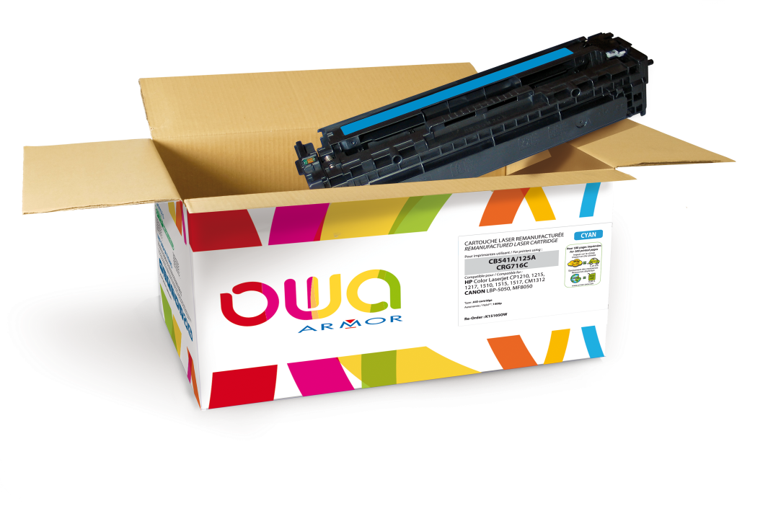



What does OWA provide?
OWA: A complete solution
Sustainable development benefits
A range
of cartridges
remanufactured
through OWA
      Collection
      Sorting and dismantling
      Materials assessment
      Office accessories made from recovered materials
      The Product Range
      Packaging
      Quality
      Cost per page
A print quality garanteed
An optimized cost per page
An environmental footprint reduced
Notes:
OWA ce sont des cartouches d’impression remanufacturées par ARMOR enrichies de nombreux services qui assurent véritablement un traitement de fin de vie .
Les cartouches d’impression sont collectés et ont réellement une 2nd vie : soit comme cartouche d’impression remanufacturée , soit de nouveaux produits issus de la valorisation des matières démantelées.
OWA une offre tout-en-un adaptée aux entreprises.

Slide 6

OWA: Reduced environmental impact
A full and unique printer cartridge processing procedure enables our environmental footprint to be reduced
Eco-designing remanufactured cartridges
Preparing materials for re-use
Manufacturing remanufactured cartridges
Sorting + repairing for re-use
Dismantling and separating secondary materials
Circular economy loop for derivative products
Creating derivative products
Marketing cartridges
Collecting used cartridges
Collecting derivative products
To sum it up, OWA and the CE mean…

Slide 7
A range of eco-designed remanufactured cartridges:
ENVIRONMENTAL LABELLING
Recovery of materials
Derivative products
Materials assessment
Collection
Sorting and dismantling
Eco-designed remanufactured cartridges
Comparison between
remanufactured OWA HP1010
and new OWA HP1010
Armor's strengths:
Armor has pioneered environmental labelling in its sector.
The initial comparative calculations for remanufactured laser printer cartridges compared to new are promising:
remanufactured cartridges
have almost 30% less impact!
-26%
-27%
Did you know?
ARMOR produced the French methodological guidelines,
which were approved by ADEME in 2014.
Data relating to new laser printer cartridges:
production of a new laser printer cartridge was simulated at a manufacturing facility in Morocco according to the ( AFNOR guide "best practice guidelines on environmental labelling / BPX30-323-0", and "methodological guidelines for the environmental assessment of remanufactured laser printer cartridges" published by Armor and SGS laboratory) excluding collection.
Note that the simulated values are underestimated, as no transport of raw materials was taken into account.

Slide 8

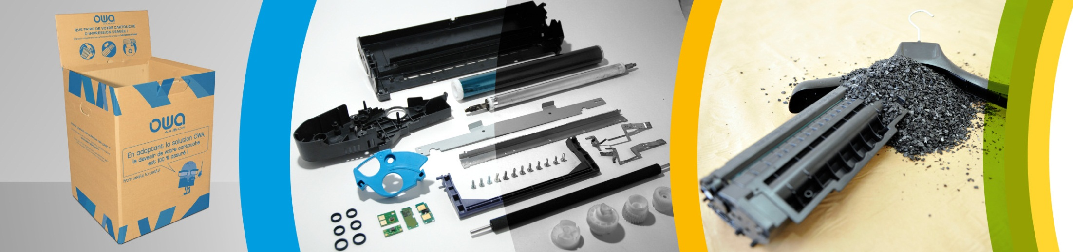
Collection through Armor
Recovery of materials
Derivative products
Materials assessment
Collection
Sorting and dismantling
Eco-designed remanufactured cartridges
Collection enables used printer cartridges to have a second life
OWA offers you a customised solution for collecting cartridges
from your business.
Setting up customised, traceable collections enables you to obtain a materials assessment, which shows the extent of your commitment.
A unique procedure introduced by ARMOR ensuring
100% recycling of collected cartridges.
0 landfill, 0 incineration

Slide 9
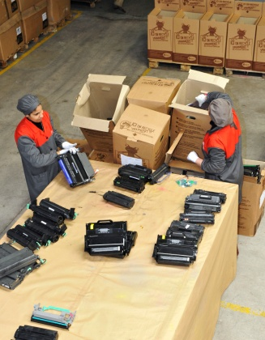
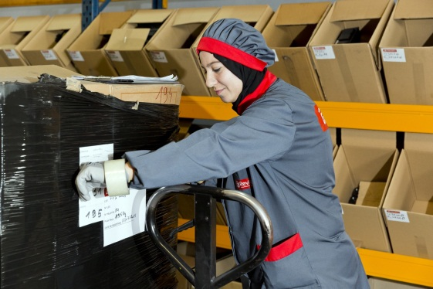
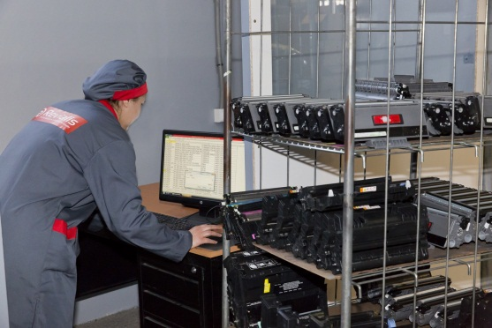
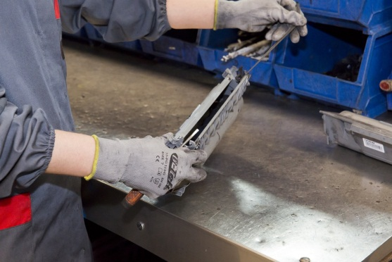
Sorting and dismantling
Laser printer cartridges
Recovery of materials
Derivative products
Materials assessment
Collection
Sorting and dismantling
Eco-designed remanufactured cartridges
All cartridges collected by Armor are sorted at our factory.
Cartridges are repaired where possible
or fully dismantled if not.
ALL components are then sorted by material type and 100% recovered.
Every material is pure and therefore fully recyclable.

Slide 10
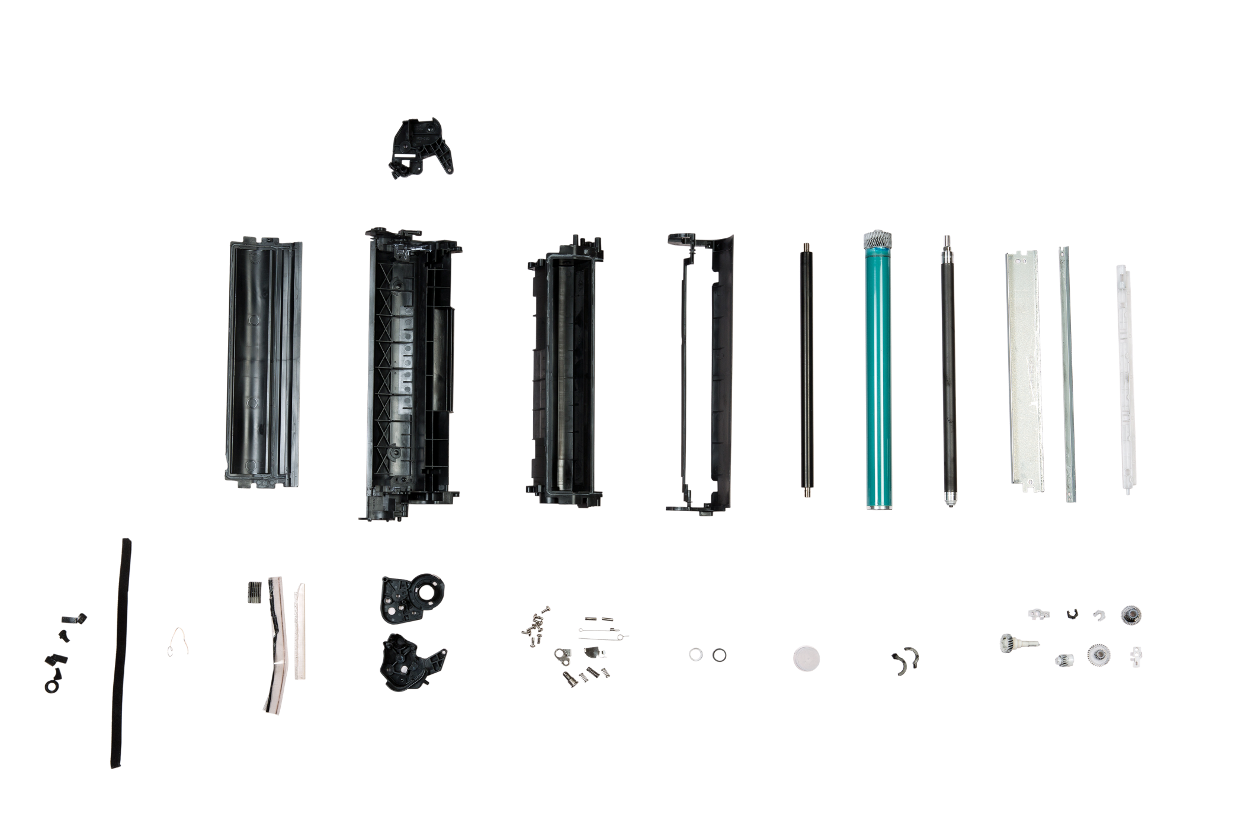

Dismantling
Recovery of materials
Derivative products
Materials assessment
Collection
Sorting and dismantling
Eco-designed remanufactured cartridges
E.g. OWA HP 1210 laser printer cartridge

Slide 11
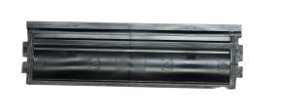
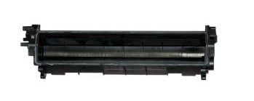
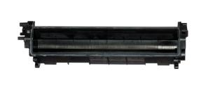
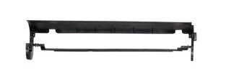
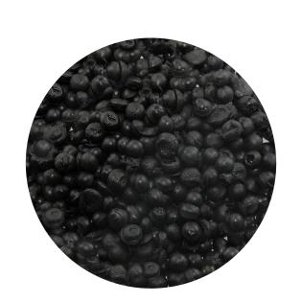
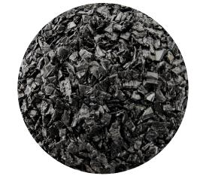
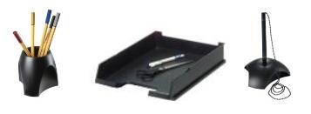
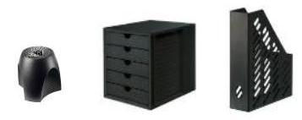
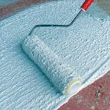
Dismantling and recovery of materials
Recovery of materials
Derivative products
Materials assessment
Collection
Sorting and dismantling
Eco-designed remanufactured cartridges
E.g. OWA HP 1210 laser printer cartridge
PS
Toner powder
Office Accessories
Components for manufacturing industrial products (metalwork, paint, injection-moulding plastic, etc.)
More examples

Slide 12

Online
Service
Sustainable Development

Slide 13
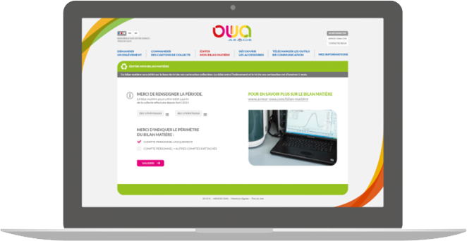
FREE ONLINE SERVICES: www.owa-collect.com
24/7 online service
Secure, customised online area
A simple, clear site with access for all
Carton pick-up request
(24 to 72-hours)
Order for collection cartons
(24 to 72-hours)
Printing of Materials Assessment on request
Take a look at the office accessories
Download
communication tools (posters, etc.)
Manage your contact details
and view your history
(carton pick-ups and orders, etc.)
Find out more

Slide 14
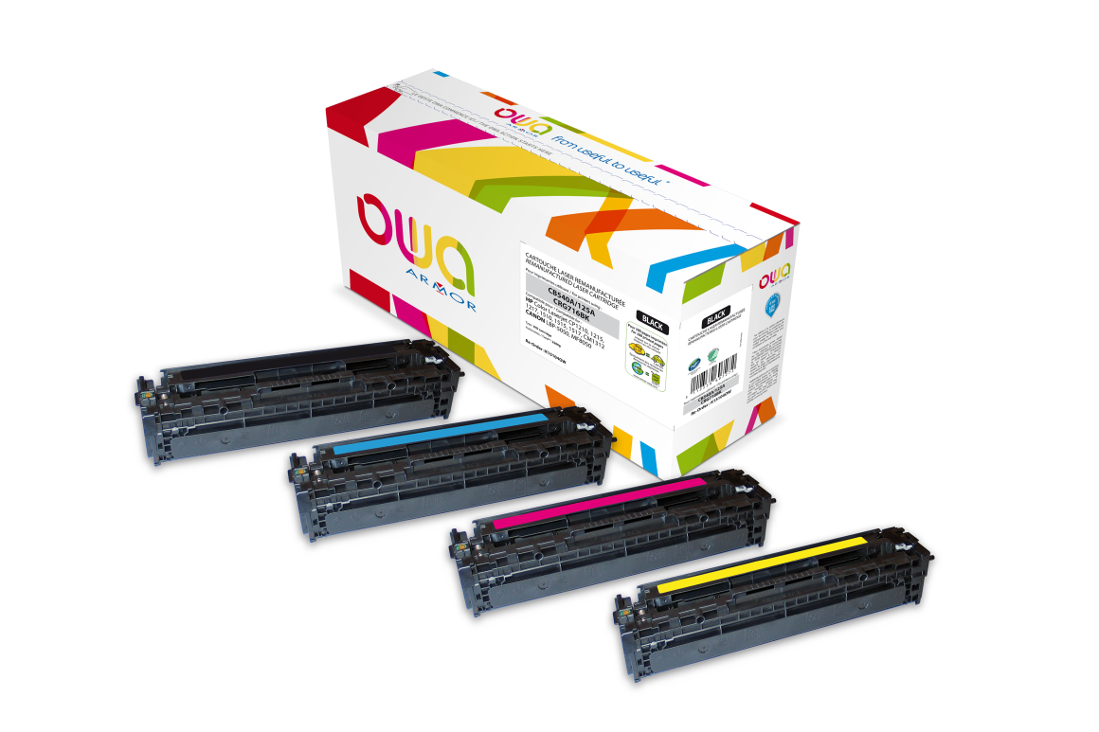
A wide range of remanufactured cartridges
460 ARMOR Laser printer products
596 OEM products covered
(Including multi-brand)
A wide range of colour products: 313 products
10 OEM brands
90% coverage of installed printers
1/3 of products available in high or very high capacity version
(improved cost-per-page)
Universal and "multi-brand" products
(improved stock management)
Business Inkjet range: HP 970/971, HP 980

Slide 15







Quality
Guaranteed quality:
Similar print quality to OEM
R&D and production process
expertise
Product certifications: Ecolabels:
International test standards:
Safety and quality of components
Standard applicable to remanufactured cartridges
SDS (Safety Data Sheet):
REACH: Legislation of the safe use of chemical substances (powder, components)
Product performance guarantee
Remanufactured cartridge guarantee
Environmental responsibility guarantee
End-user health guarantee
User benefits
Quality and components

Slide 16
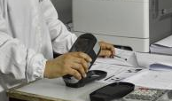
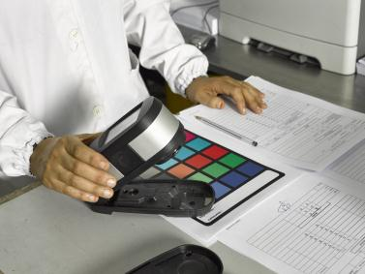
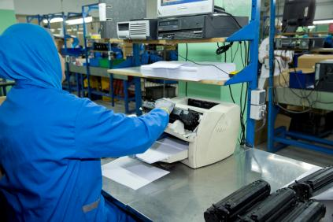
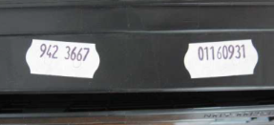
Production
Print quality tests carried out at each stage of production
Traceability
2 labels are placed on the carton ensuring full traceability and certifying compliance with ARMOR standards.
Monochrome
Colour
Unit testing

Slide 17
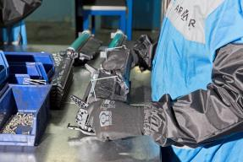
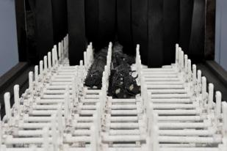
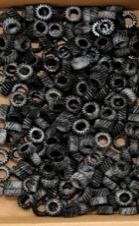

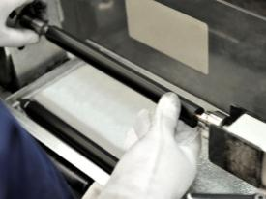
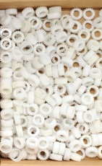
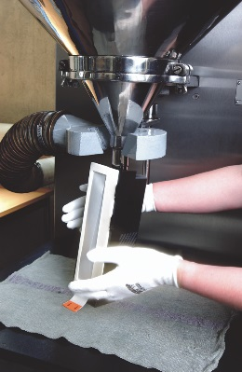
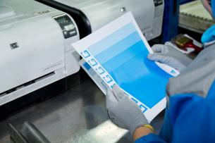
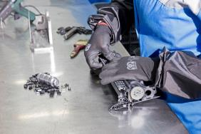
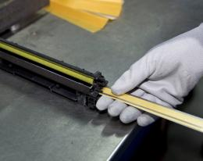
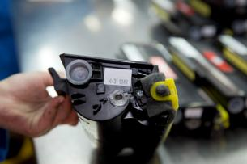
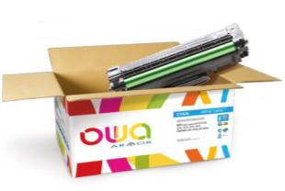
Manufacturing process in pictures
Before
After
Quality
control
Dismantling
Cleaning
Machining
Quality
control
Quality
control
Quality
control
Quality
control
Print tests
Assembly
Fitting cover
Quality
control
Filling
Quality
control
Traceability
Packaging

Slide 18


ARMOR Services & Guarantees
Lifetime guarantee on Armor Laser printer cartridges
Armor offers an unlimited warranty on the faultless operation and reliability
of its laser printer cartridges, regardless of the date of purchase.
Following inspection of the consumable by its technical department, ARMOR undertakes:
To exchange - free of charge - consumables considered to be defective.
If the printer stops working, a qualified technician will be tasked to take action on-site in under 8 working hours in France, or 24 hours throughout Europe.
To cover any repair costs to the printer if it is shown that the incident was caused by an ARMOR consumable.
A free Hotline accessible from anywhere in Europe
Did you know?
Use of Armor compatible cartridges cannot
invalidate the printer manufacturer's guarantee.

Slide 19
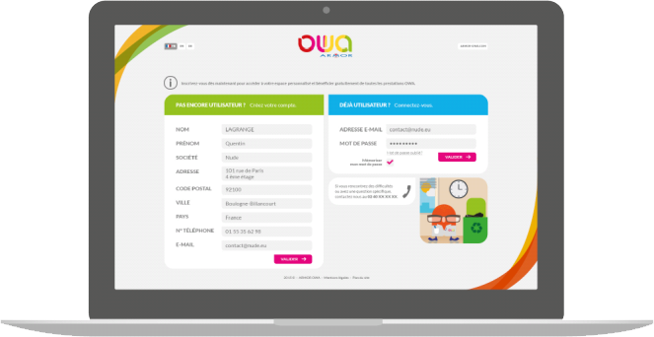
How it works:
Sign up directly online
or by calling the collection sales department
Receive your username and password
by email
You're ready to sign in!
Direct access at www.owa-collect.com
or via the website at www.armor-owa.com

