Slide 1
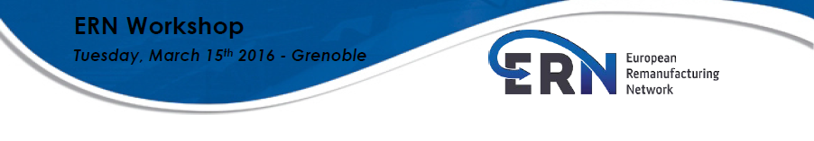
Best practices and future challenges in remanufacturing
15th of March 2016 at University of Grenoble Alpes - Grenoble FRANCE

Slide 2
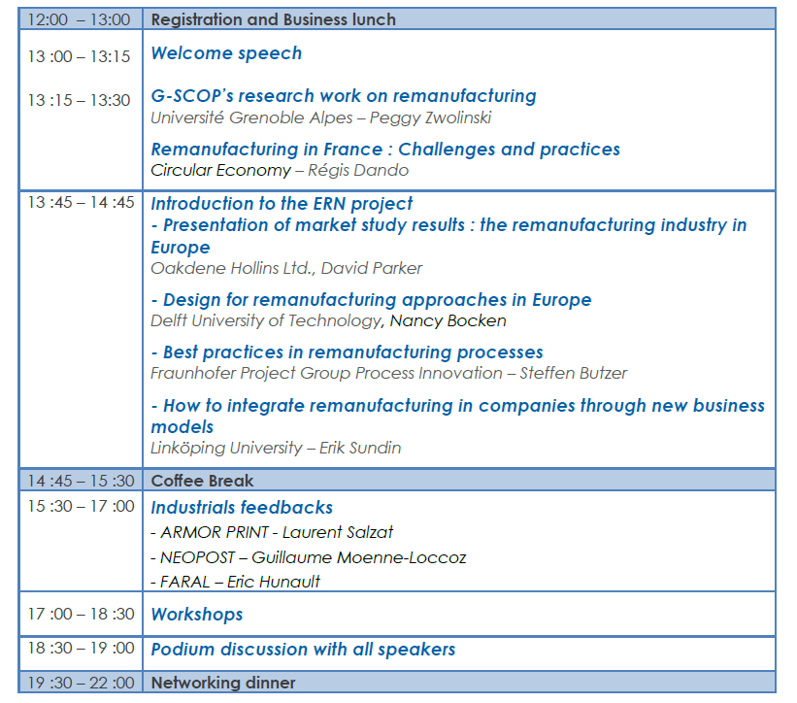

Slide 3










European Remanufacturing Network
Funded by the Horizon 2020
Framework Programme of the European Union

Slide 4
ERN project goals
Map the remanufacturing landscape in Europe.
Equip remanufacturers and would-be remanufacturers with the tools to remanufacture profitably and resource-efficiently.
Raise the profile of remanufacturing in the public and political and policy making spheres.
Facilitate the development of sustainable partnerships between remanufacturing organisations for future research, collaboration, knowledge transfer and lobbying.
Set up a European Remanufacturing Council (ERC) that will represent the views of remanufacturers across Europe and continue the work started under the Council after the project has completed.

Slide 5

https://www.remanufacturing.eu/

Slide 6
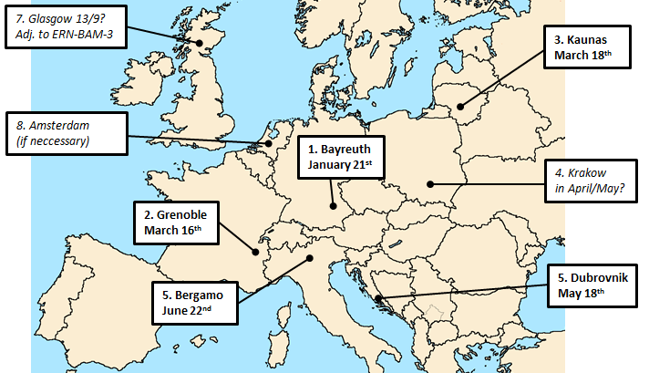
ERN planned workshops
[WP 5.1, 5.2 / Workshops]
✓
✓

Slide 8
G-SCOP’s research work on remanufacturing
Peggy Zwolinski
University Grenoble Alpes
Best practices and future challenges in remanufacturing
15th of March 2016 at University of Grenoble Alpes - Grenoble FRANCE

Slide 9
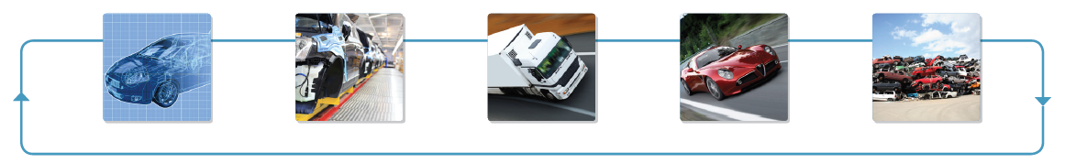
G-SCOP
G-SCOP Laboratory
Sciences pour la Conception, l’Optimisation et la Production de Grenoble
Grenoble laboratory of Sciences for Design, Optimization and Production
A multidisciplinary research laboratory answering the stakes in product design, optimization and production systems
To answer new scientific challenges related to industrial mutations
Notes:
Out-sourcing, Offshoring, Development of services, Evolution of Products

Slide 10
2 centers – 6 research topics
Optimisation & Prod. Syst. Center
Integrated Design Centre
Combinatory Optimisation
Product/Process Design
Operations Research for
Production Systems
Transversal Projects
Collaborative Design
Information Sytems and Product
modeling (CAD Systems)
Management and Control of
Production Systems

Slide 11

Objectives of the product process design group
To propose methods to design simultaneously the product and its lifecycle integrating the experience and the knowledge linked to the lifecycle
  - Understanding and modeling of the Expertises linked to the Product Lifecycle (Domain Experts and Users)
  - Integration of the Experiences and Knowledge into Design Systems (User Interface Tools, Libraries, Integration Models, Design Methodologies)
Environmental issues
Additive manufacturing

Slide 12
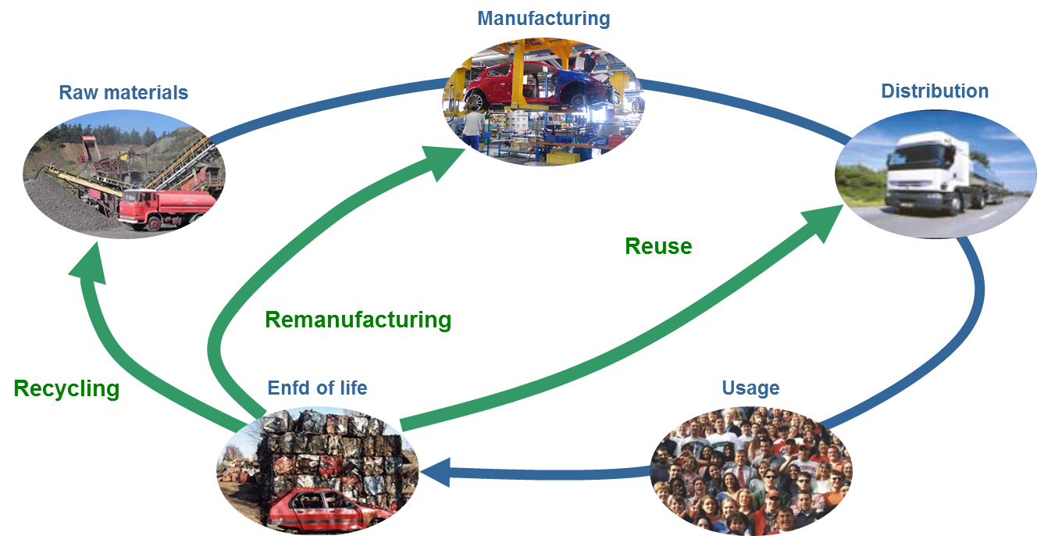
Research area
Researches are related to products or product service systems life cycles (design, manufacturing, distribution, usage, end of life scenario…)

Slide 13
Remanufacturing principles
Remanufacturing is a recycling technique that enables products and components at their end-of-life to serve as a stock of resources for manufacturing new products which quality is at least equal to the quality of products made from extracted raw materials.
  Keep the maximum of value of the unuseful products and components in the economy
  Use this value in a new cycle of a product life
  Make as many life cycles as possible

Slide 14

Main research questions of the group since 2003 and where remanufacturing issues are from the design perspective
Towards remanufacturing, part of the industrial system
DFX – second usage
Closed loops PSS
PSS Life Cycle
Design2life
ServINNOV
Velo’v
DFX - Recycling
Recobat
2003
2005
2008
2011
2014
2017
Life Cycle for designers
Remanufacturing process
DFX - upgrade
IDCYCLUM
Reman
Characterisation
RENAULT
CLOEE
DFX - usage
REPRO2
EcoUse
Evolution of remanufacturing business models

Slide 15
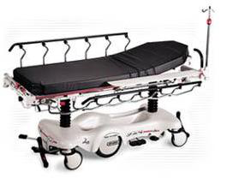
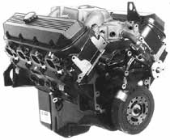



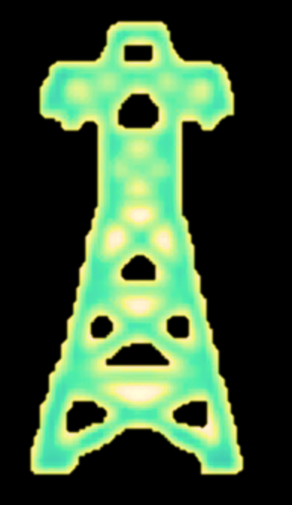

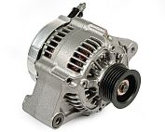
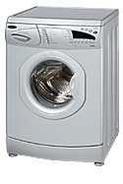


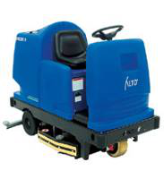
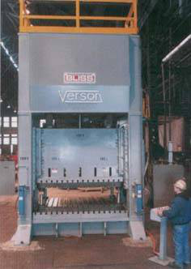
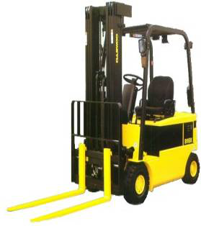






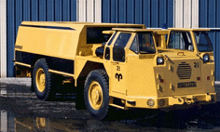

Remanufactured products : business vs sustainability
Many kind of products are remanufactured but what is known about their sustainability?
Use of renewable energy & guarantying a sustainable use of this resource
Ecodesign & clean energy strategy
Product Life Cycle
Minimum burden waste treatments
Reducing & optimising non renewable energy usage efficiency
Waste = resource paradigm
Environmentally friendly consumption
Sustainability issues studied

Slide 16
Remanufacturing issues
From “Remanufacturing, a business by itself”
  Check whether the business can be adapted to remanufacturing principles (tool Repro²)
  Assess the environmental performance of the production system (tool Cloee)
  Eco-design the product and its usage (eco-design and eco-usage rules and models)
To “Remanufacturing, an approach to support sustainable industrial solutions”
  Develop new technologies to support sustainable remanufacturing
  Design product for several lives

Slide 17
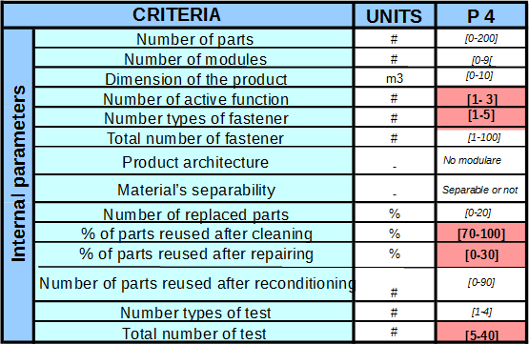
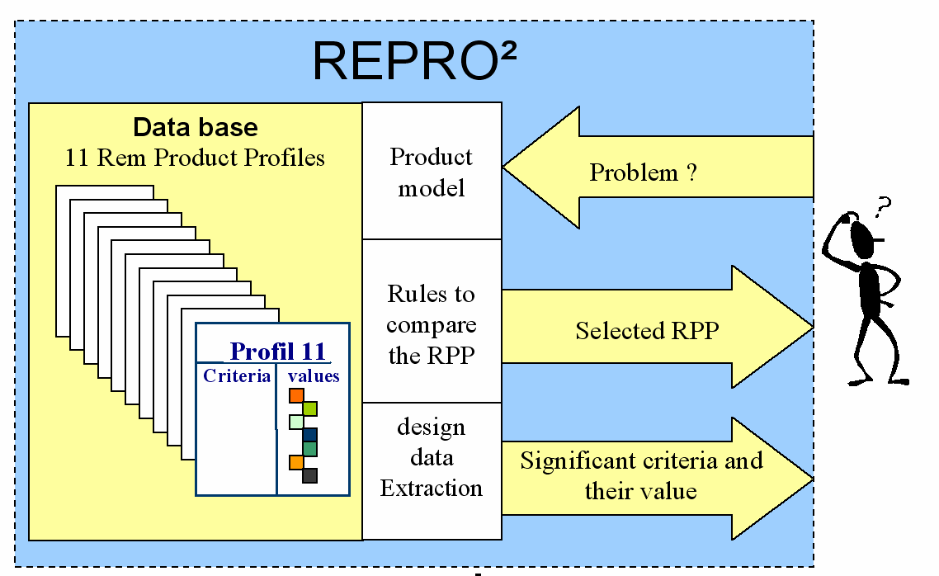
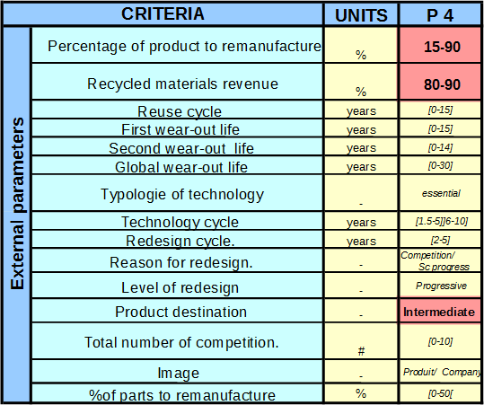
Does it make sense to move your business to a PSS / Remanufacturing approach ?
Zwolinski et al., Journal of Cleaner Production 2006

Slide 18


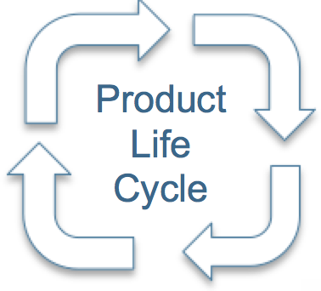


Modelling to support engineers assess the environmental performance of the designed system
Manufacturing
Environnemental impacts of component 1 ?
Life Cycle Assessment frame adapted to product designers activities
Raw material
Distribution
Environmental impacts per life cycle stage?
End of Life
Product Use
Each « brick » contains its own environmental impact
Product
Comp. 1
Material
Component 1
Manufacturing & Assembly
Comp. 1
Distribution
Comp. 1
End of Life
Comp. 2
Material
Component 2
Manufacturing & Assembly
Comp. 2
Distribution
Distribution
Comp. 2
End of Life
Assembly
Use
Recovery
Components
Comp. 3
Material
Component 3
Manufacturing & Assembly
Comp. 3
Distribution
Comp. 3
End of Life
Gehin et al., Journal of Cleaner Production 2008

Slide 19
Modelling end-of-life scenarios to assess their environmental performance
Raw Material
Manufacturing
Comp. Manufac.
Raw material
Distribution
Comp. Distrib.
End of Life
Product Assembly
Product Use
λ Recollection Process Performance
Product Distrib.
1
k Number of use cycles (loops)
ρ
Product Use
δ Non remanufacturable collected cores
N Total number of products collected
1-ρ
Product Take Back
ρ
Number of cores considered as non recollected
(1-ρ) λ
η [1 - δ](1-ρ) λ
(1- λ) (1- ρ)
Warehouse
Processes capable to upgrade the component performance
[1 – δ] (1-ρ) λ
[1-ρ) λ]δ
δ Ratio of components discarded
η
Amaya et al.,
Journal of Engineering Design, 2014
Remanufacturing
Recycling
η Remanufacturing Performance
(1- η) [1 - δ](1-ρ) λ

Slide 20
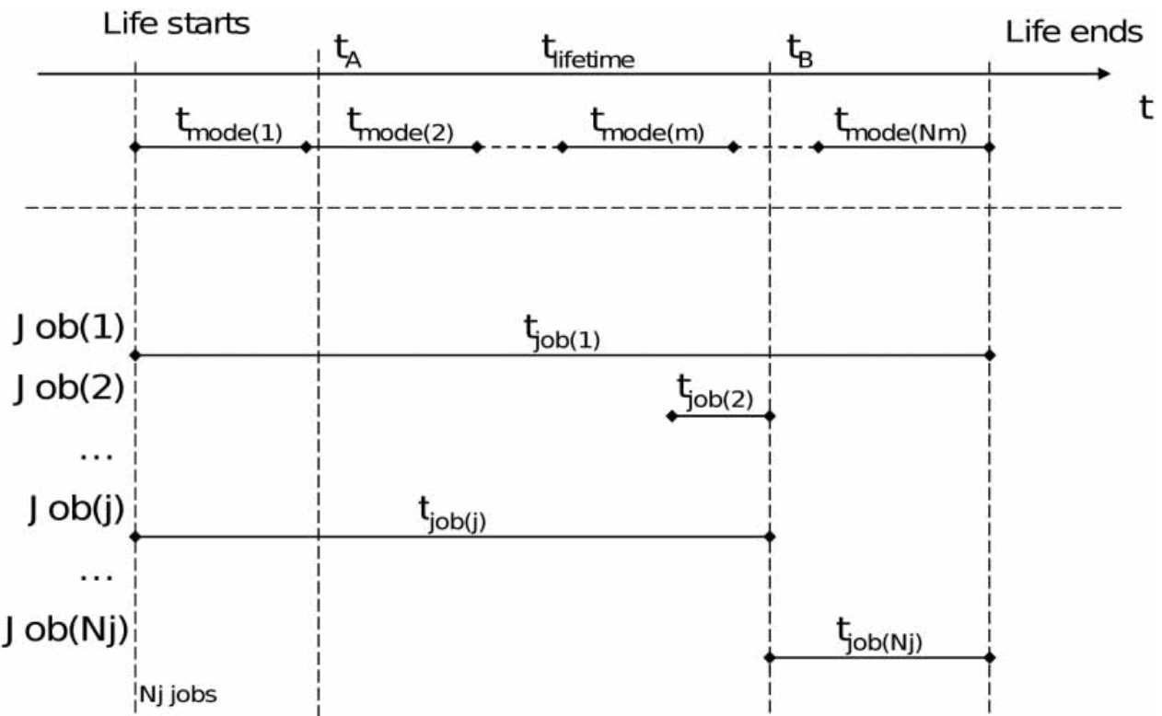

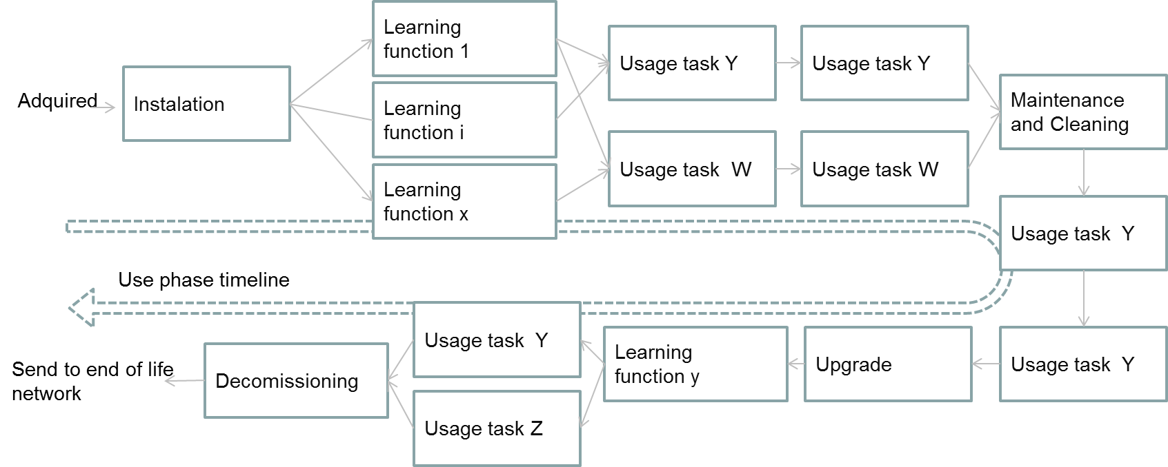
Modelling the use phase and eco-usage rules
Interactions
Manufacturing
+
Raw material
Models of Interactions
Period of time
Distribution
End of Life
Product Use
+
User in context
Modeling use stage (specific task = job) aligned with moments (time spent)
Product
Task i (=>power, flows) * time i = « real » consumption (energy, flows)
Domingo et al., Journal of Engineering design, 2011

Slide 21
Remanufacturing issues
From “Remanufacturing, a business by itself”
  Check whether the business can be adapted to remanufacturing principles (tool Repro²)
  Assess the environmental performance of the production system (tool Chloe)
  Eco-design the product and its usage (eco-design and eco-usage rules and models)
To “Remanufacturing, an approach to support sustainable industrial solutions”
  Develop new technologies to support sustainable remanufacturing
  Design product for several lives

Slide 22
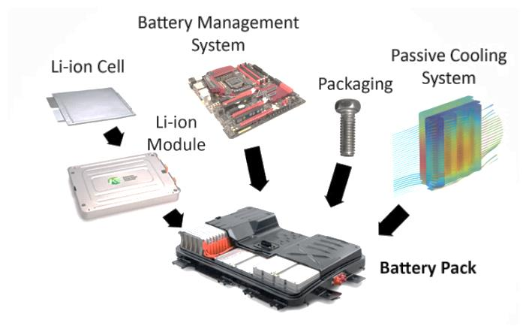
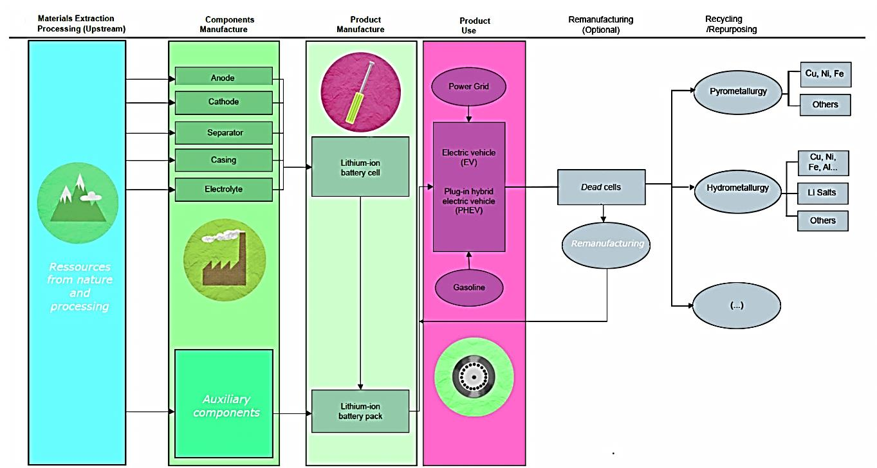
Develop new technologies and values chains to support sustainable remanufacturing
Issue: how to ensure lithium supply security in the future?
Lack of end-of-life infrastructure to recycle/remanufacture batteries
E.g. Recycling and ecodesign of Lithium batteries
Ecodesign new technology adapted to technology designers in industries
Design recycling plan network & infrastructure
ANR RECOBAT, 2013-2016

Slide 23
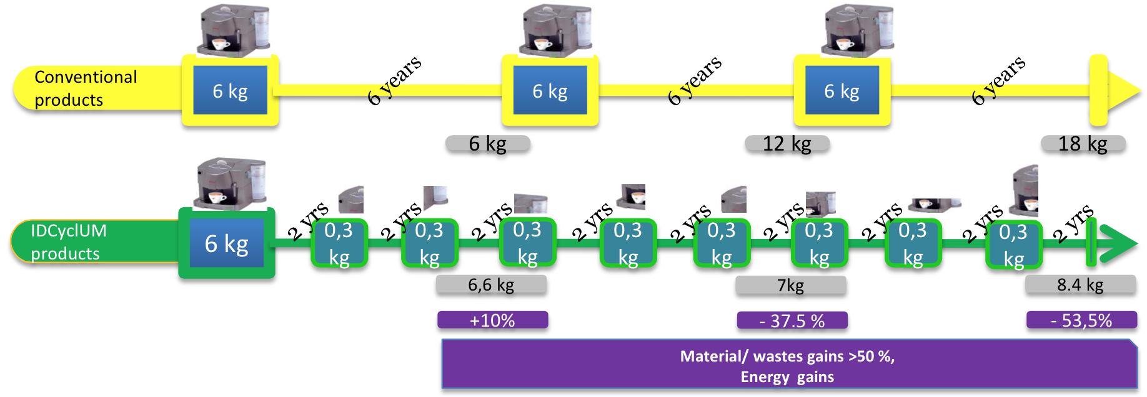
Design by including upgrades to extend lifetime of products
Types of upgrade and mechanism of the most appropriate form selection
  More technology
Environmental validity of upgrades (energy efficiency)
  Total lifespan environmental footprint
  Keep/increase the functional value
Manufacturing
Raw material
Distribution
End of Life
Product Use
How to develop « evolutionary products » able to adapt themselves gradually
ANR IDCYCLUM, 2012-2015

Slide 24
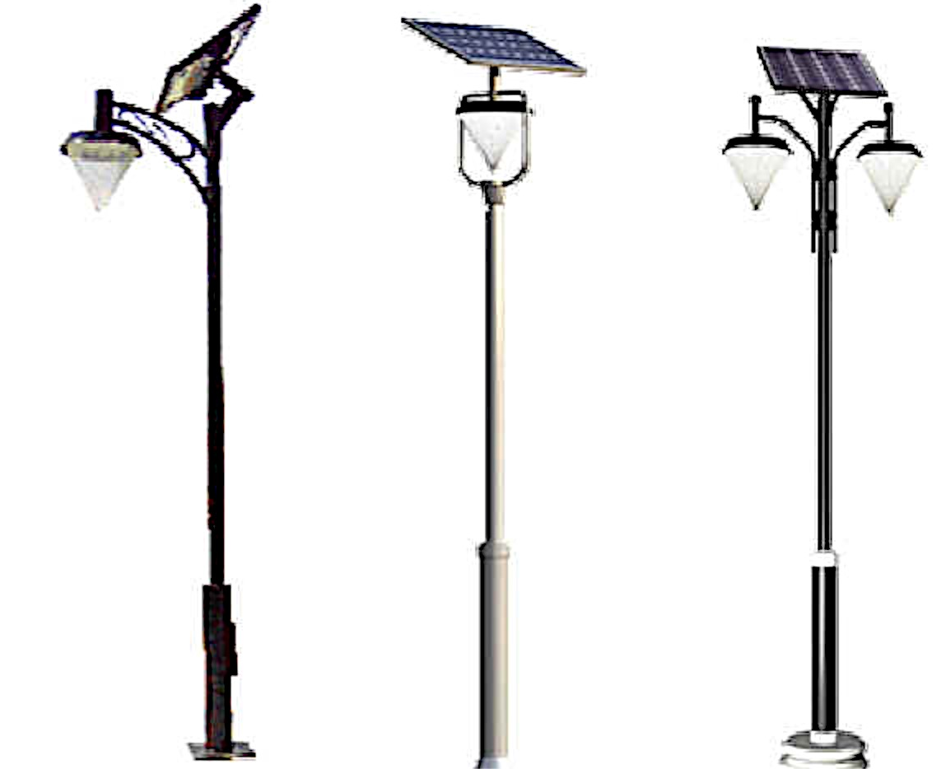
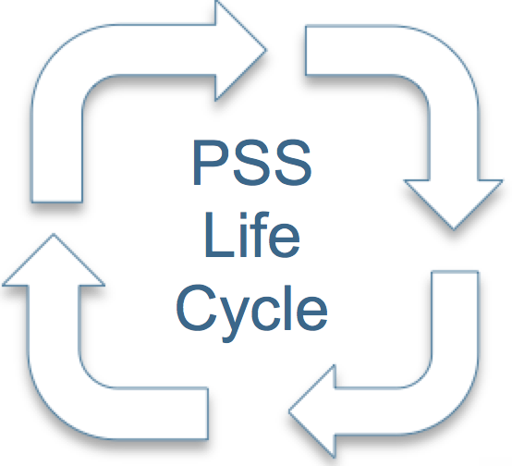
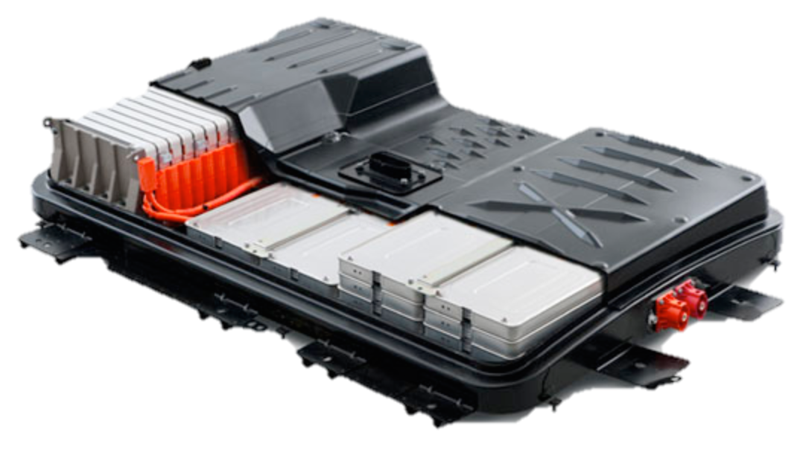
Design products for several lifes
Manufacturing
Raw material
Distribution
End of Life
Manufacturing
Product Use
+
Raw material
Reman
Distribution
End of Life
Product Use
Second life Batteries
In a autonomous public light
Batteries in a car
Design2life, 2015-2018

Slide 25

Conclusions
Environmental sustainability of remanufacturing can be there when
  Considering the system as a whole and remanufacturing as a part of the value chain
  Incorporating innovation to add value for the customer; technological, organisational and usage innovations are called
  Changing deeply users’ behaviours; sustainability results come from both users and manufacturers
Design and engineering have to move to new techniques and methods to support innovative solutions including remanufacturing
Need of design methodologies and indicators dedicated to sustainable remanufacturing

Slide 26
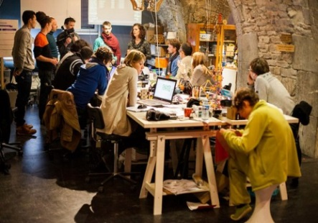
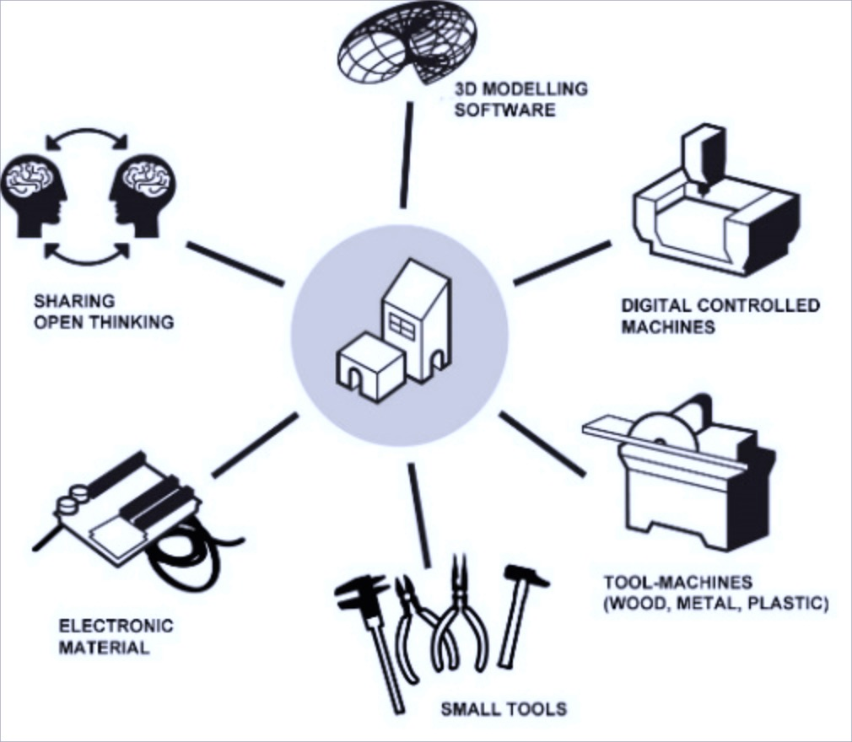
New challenges
Fablabs
New societal objectives
  Every product (Personnalized and one-of-a-kind products; Simultaneous multiple users product)
  Everybody (Remanufacturers are professionals or not; Multiple users)
  Everywhere (Capacities; Expertise; Material)
New remanufacturing concepts
  Continuous transformation capacities (Manufacturing, Maintenance, Remanufacturing)
  Open science (Co-design, Open knowledge)
  Personal material dotation (Transform it, Exchange it)
Fundamentally, it is design
?

Slide 27
Thank you for your attention
Best practices and future challenges in remanufacturing
15th of March 2016 at University of Grenoble Alpes - Grenoble FRANCE

Slide 29
Introduction to the ERN project
Best practices and future challenges in remanufacturing
15th of March 2016 at University of Grenoble Alpes - Grenoble FRANCE

Slide 30
Industrial feedbacks
Best practices and future challenges in remanufacturing
15th of March 2016 at University of Grenoble Alpes - Grenoble FRANCE

Slide 31
Workshops
Best practices and future challenges in remanufacturing
15th of March 2016 at University of Grenoble Alpes - Grenoble FRANCE

Slide 32
Podium discussion with all speakers
Best practices and future challenges in remanufacturing
15th of March 2016 at University of Grenoble Alpes - Grenoble FRANCE

Slide 33
Conclusion of the day
Best practices and future challenges in remanufacturing
15th of March 2016 at University of Grenoble Alpes - Grenoble FRANCE

