Slide 1

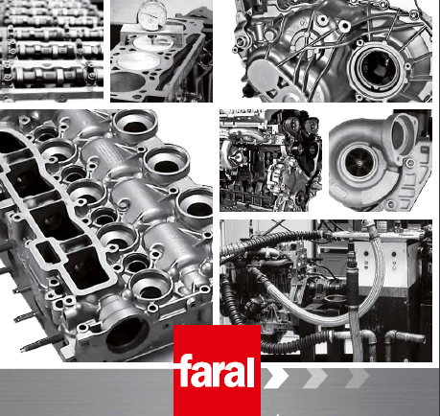
FARAL

Slide 2
FARAL was created in 1932 by Jean HUNAULT
1958: reconstruction of aircraft engines
1965: FARAL begins selling standard exchange engines (petrol engines)
1989: start of production of standard exchange diesel engines
2002: start of production of standard exchange cylinder heads
2006: Design and launch of the range and turbo gearboxes ech / std
2012: Market opening EXPORT

Slide 3
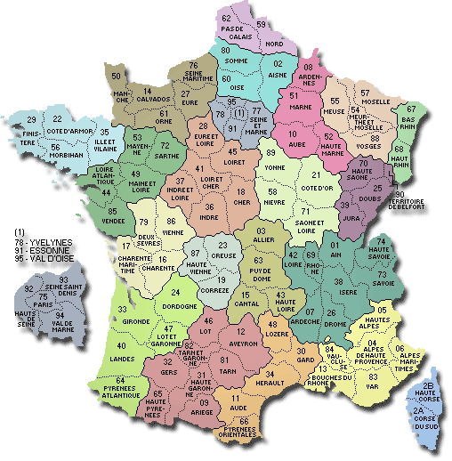
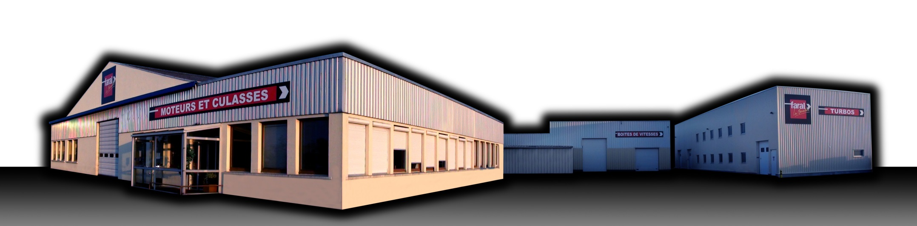
FARAL Location
www.faral.fr
FARAL is located in the west of France, Laval, and employs 68 people.
Annual production ech / std:
2000 Engines
2500 yokes
1000 gearboxes
6000 turbos

Slide 4
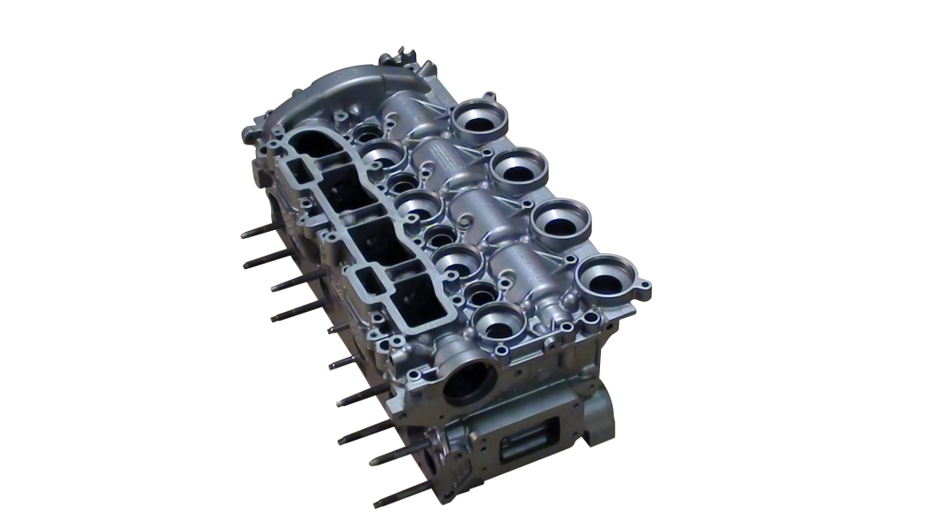
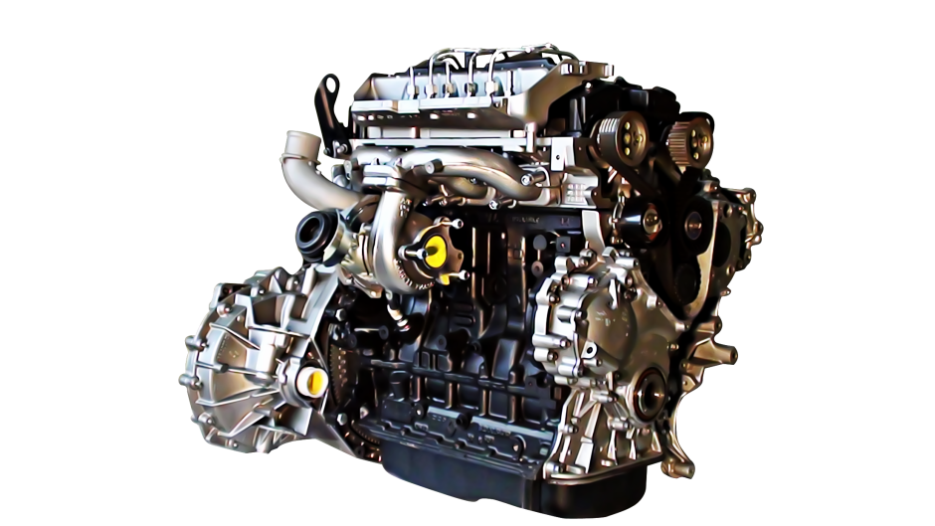
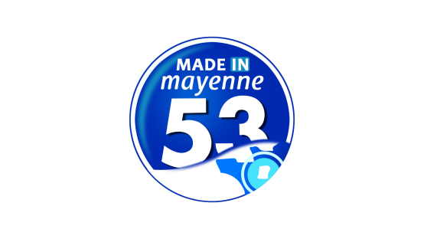
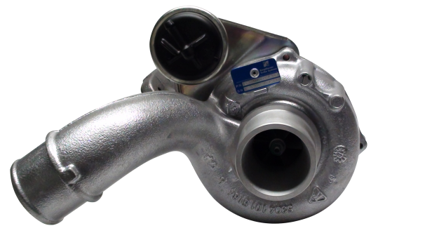
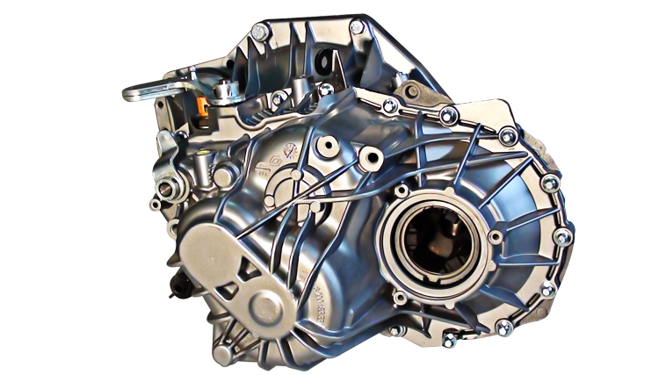
FARAL Products and Labels

Slide 5


FARAL products, family company founded in 1932 in Laval (53) are now stamped "green trade" label.
For the first time, a patent guarantees quality an engine standard exchange The renovation process of the water circuit of the yokes of standard exchange engines is now the subject of a patent. (INPI registration No. 14575 03 / No. 2863517 publication) with this official title, FARAL wants to give visibility to an intrinsic quality of the engine.
French manufacturer of engines, cylinder heads, gearboxes and turbochargers for remanufactured automotive

