Slide 1
Remanufacturing: View from Design
Prof. Nancy Bocken,
Dr Sharon Prendeville, David Peck
Grenoble 16th March

Slide 2
Objectives
Understanding of DfRem activities through real world examples
Linkages between DfRem and business models
Pros and cons of specific product designs from economic and environmental perspectives
Challenges companies experience

Slide 3
Activities
12 case studies
  seven OEMs / five independents / two consortia
  sectors: EEE, auto, ICT, Medical devices, furniture, HDOR
13 interviews / 10 site visits
Desk research, literature review and analysis
Notes:
EEE- Electronics and Electrical Equipments
HDOR - Heavy duty off-road

Slide 4

Location: Treforest, Wales
Type: OEM
Maturity: Piloting / Experienced
Product: Furniture (task chairs) / Mid-high end​
Designed for serviceability / robust /high residual value
Product Life: 5 years
Good supply & good demand​
Markets: Corporate clients​ / business-to-business ​

Slide 5
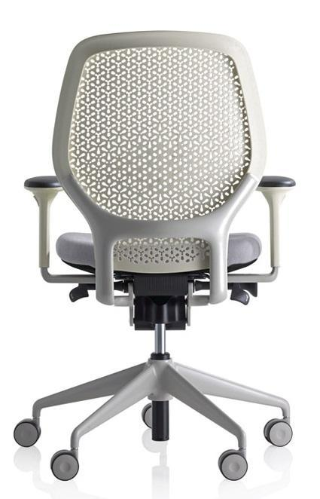
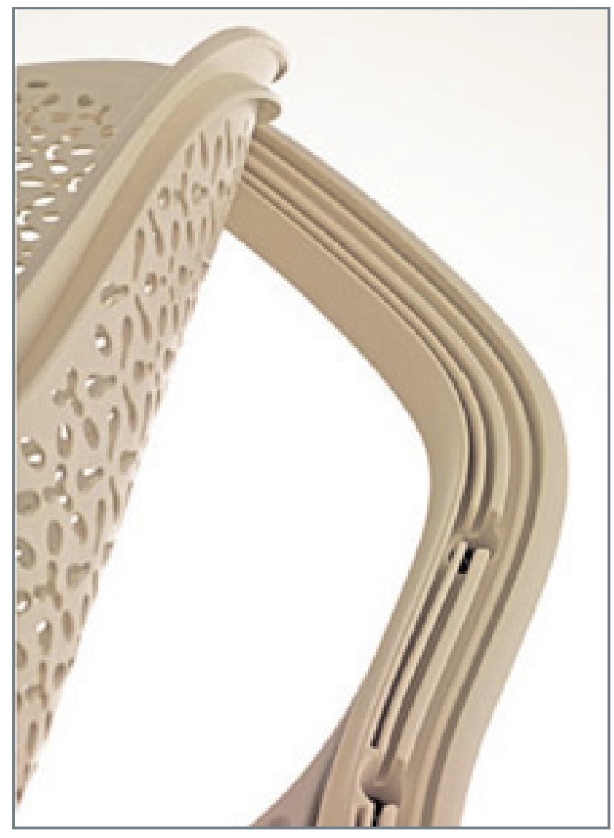
durable materials (eg aluminium),
streamlining parts and integrating functions
easy manually disassembly to facilitate efficient remanufacturing / limited fasteners (fig)
upholstery and castors as well as the seat foam can be easily removed
Notes:
Design features suited to remanufacturing, but understanding how to manage durability and lightweighting in remanufacturing

Slide 6






Company: Fuel Cell Recovery (FCR)
Location: United Kingdom
Product: Hydrogen Fuel Cell stack
Maturity: Piloting

Slide 7
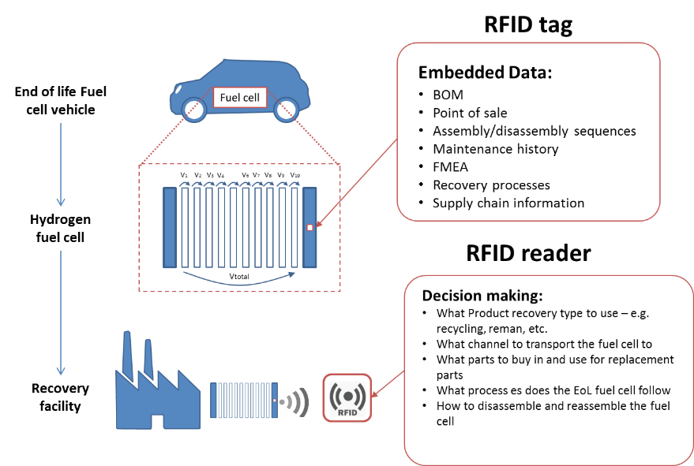
Joining methods, fasteners, part connections
(eg avoiding gaskets attached with strong adhesive)
Lightweighting (fragility of components, risk break during handling (brittle flow field plates made of graphite)
RFID tags, electronic data logs and sensors – measure voltage and temperature of the cells to assess condition / trigger the reman ops
Tracking history as well as data about Bills of Materials, known failure modes, test data and original performance and build specifications

Slide 8
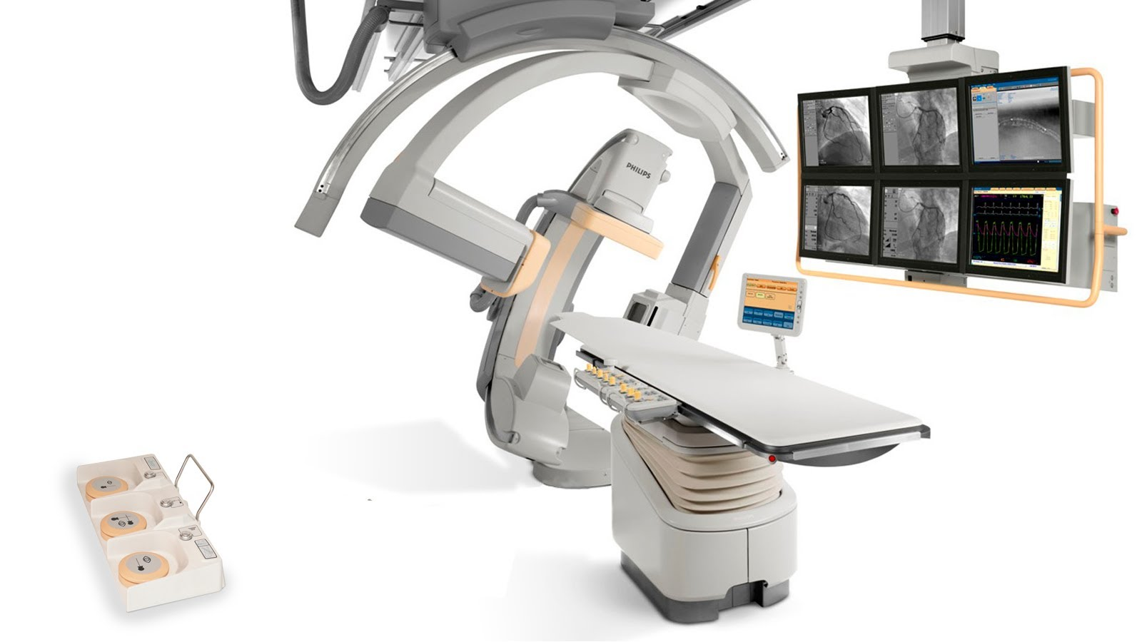

Company: Philips Healthcare
Location: Best, The Netherlands
Product: Diamond Select Allura Xper FD20/10
Interventional X-ray system
Type: OEM
Maturity: Experienced

Slide 9

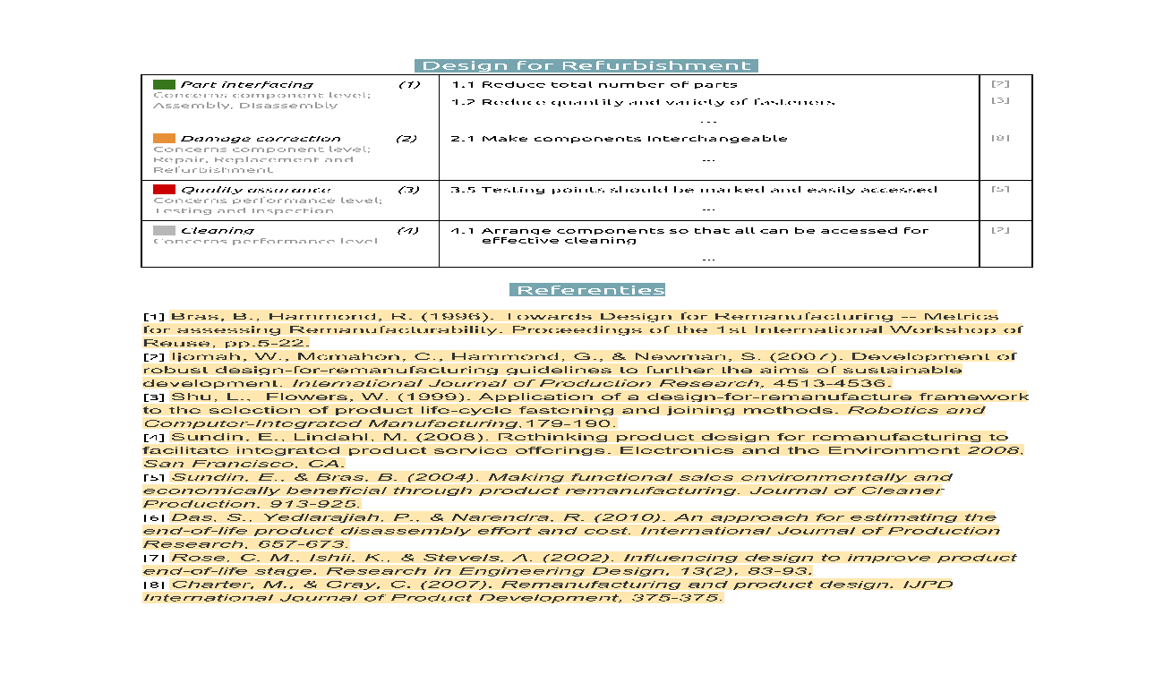


Framework for Design for Refurb.
Component level
1. Part
interfacing
2. Damage
correction
3. Quality
assurance
4. Cleaning
Performance level
Nina Borsma (master’s)
Notes:
Part interfacing - disassembly
Damage correction -
Quality assurance -
Cleaning -

Slide 10
Benefits
Economic
  eg lower production costs, revenue generations, new markets, increased competitiveness, business diversification
Environmental
  eg waste reduction, GHG reduction, material savings
Social
  eg skilled and semi-skilled jobs, cohesive local workforces

Slide 11
Challenges
Standards for DfRem at national and EU level
No access to critical product life cycle data (e.g optimal point for remanufacturing / design files)
Lack of within and between company information sharing, to inform new product development
Blocking patents and lack of access to design files and Bill of Materials data
Need for collaborations between OEMs and independent remanufacturers who have remanufacturing know-how
… … and more (D3.2 report)

Slide 12
Conclusions
Design for Reman is still an underdeveloped and underexplored field
Design for Reman is largely ignored and often opportunistic rather than strategic
More needs to be done to make Reman more effective
Some companies use upgrade strategies and servicability as part of the design
Design is clearly linked to the need for new business models and technology
Recommendations for companies:
  Consider Design for Reman as a strategic opportunity
  Consider collaboration with third parties to learn from their reman capabilities
  Innovate design, business models and technology in parallel
  Potential to use RFID and tracking technology to track materials
Notes:
Unambitious and increative
The focus is on redesign
Upgrade strategy - Neopost
New sectors relevant to DfRem identified and the potential role for design explored eg Hydrogen Fuel Cell Vehicles
Participants acknowledgement importance of DfRem
But very little activity in practice, even OEMs operating refurb/reman don’t design for remanufacture (eg Neopost, Philips, Orangebox) but rather product has properties suited to remanufacturing in general
Companies unwilling to disclose information due to risks of brokers
Thrust of reman activity happening in independent who have no control over design
Relevant strategies for DfRem summarised
Disassembly most critical approach
Upgrading (eg Neopost), standardisation and product roadmaps can manage technology lifecycles
Advanced materials not a concern and/or motivator for companies profiled

Slide 13
Thank You

